Slide 1
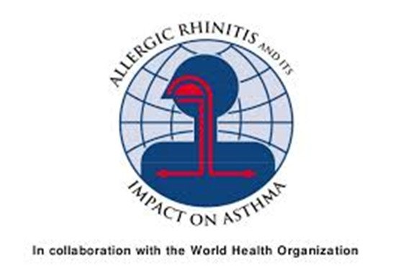
Allergic Rhinitis in Children
Doç Dr H.Tekin Nacaroğlu
Çocuk İmmünolojisi ve Allerji Hastalıkları

Slide 2
Objectives
Allergic Rhinitis , Atopic Dermatitis and Anaphylaxis
Symptoms
Concomitant disease
Diagnosis
Treatment
Prevent measures

Slide 3

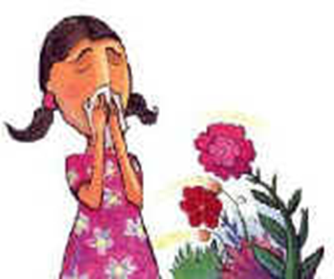
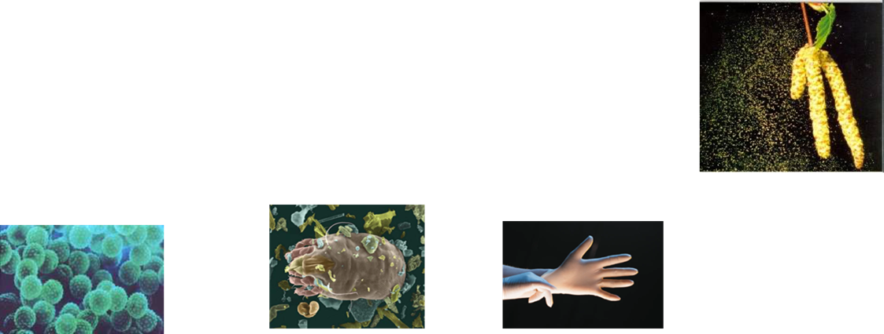
Allergic Rhinitis
Allergic rhinitis is clinically defined as a symptomatic disorder of the nose, induced after allergen exposure, by an IgE mediated inflammation of the nasal membranes.

Slide 4
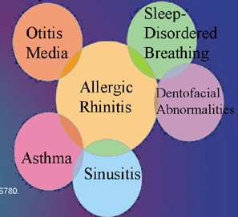
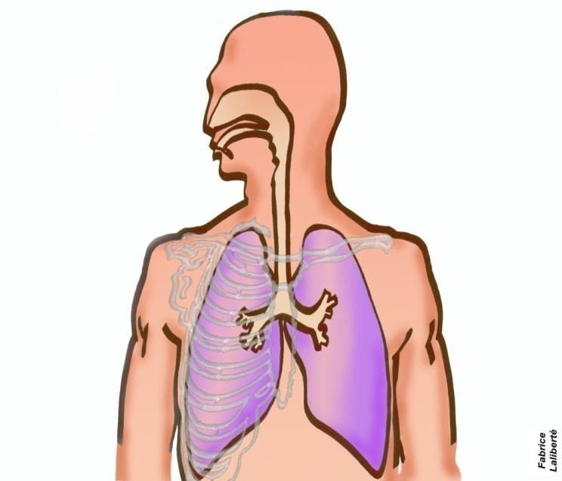
Asthma Allergic Rhinitis
40% of patients with AR have asthma
The majority of patients with asthma have AR
AR is a major risk factor for poor asthma control
All patients with AR should be assessed for asthma

Slide 5

Prevalence
The prevalence of AR has been reported to increase between 3% and 40% worldwide, depending on region and age, with an increase in prevalence
In our country, prevalence is 2.9-39.9% in children
Not mortal but effects the social life of the patient, school and work performances, and the economic burden is high.
Notes:
Küresel bir halk sağlığı sorunu olarak karşımıza çıkar

Slide 6
Allergic Rhinitis risk factors
Atopy
Male
Birth at polen season
First child
Usage of antibiotics in early age
Maternal smoking
Indoors allergens contact
Aeroallerjen sensitization in child
Food allergy

Slide 7
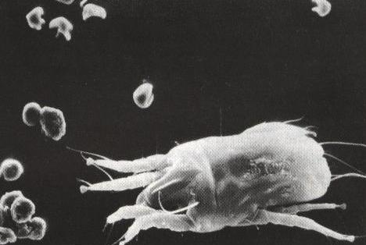
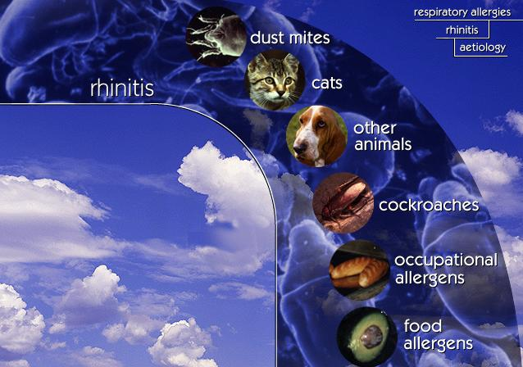
Allergens
Dust mite
Fel d1

Slide 8
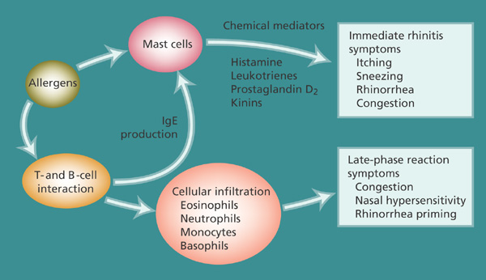
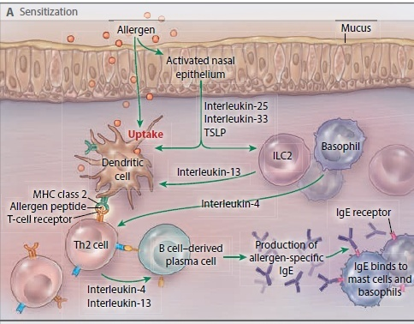
Immunopathology of allergic rhinitis:
Burun akıntısı
Burunda kaşıntı
Hapşırık
Konjesyon

Slide 9
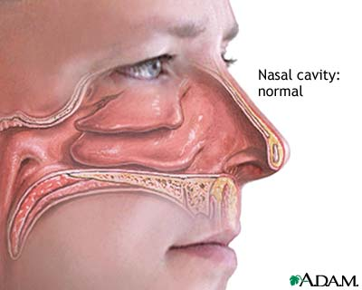
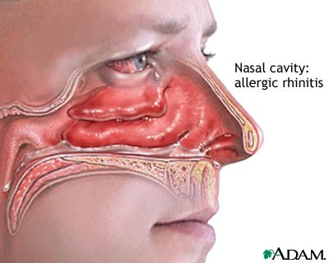
Major symptoms of allergic rhinitis: ARIA
Rhinorhoea
Nasal blockage
Postnasal drip
Itchiness
Sneezing
Associated health effects
IgE mediated

Slide 10
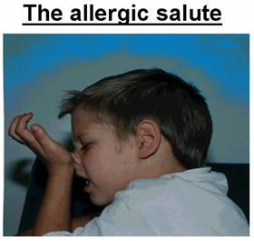
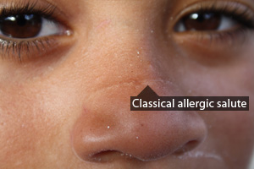
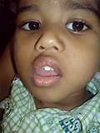

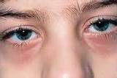
Allergic Rhinitis –Physical examination

Slide 11
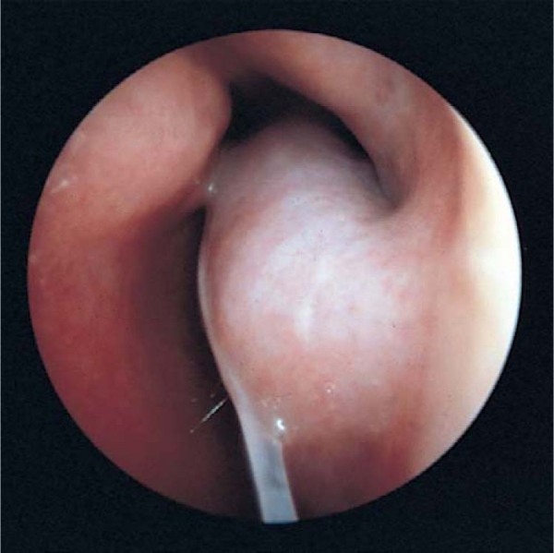
Physical examination
Notes:
Nazal mukoza soluk mavimsi veya konkalar ödemlidir

Slide 12
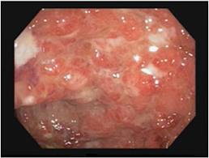
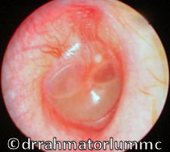
Physical examination
Cobblestone view
Serous Otitis Media

Slide 13
AR Classification
Intermittent
. < 4 days per week
. or < 4 weeks
Persistent
. > 4 days per week
. and > 4 weeks
Moderate-severe
one or more items
. abnormal sleep
. impairment of daily activities, sport, leisure
. abnormal work and school
. troublesome symptoms
Mild
normal sleep
& no impairment of daily activities, sport, leisure
& normal work and school
& no troublesome symptoms

Slide 14
Other Causes of Rhinitis in Children
Infection
  Viral, bacterial,
  Rhinosinusitis
Foreign body in the nose
Rhinitis associated with physical or chemical factors
Drug, food induced rhinitis
NARES, aspirin sensitivity
Vasomotor rhinitis

Slide 15
Diagnosis of Allergic Rhinitis
History & symptoms of recurrent or persistent rhinitis and/or associated health effects
Signs of atopy and recurrent or persistent rhinitis
Demonstration of IgE allergy
Exclusion of other causes of rhinitis

Slide 16
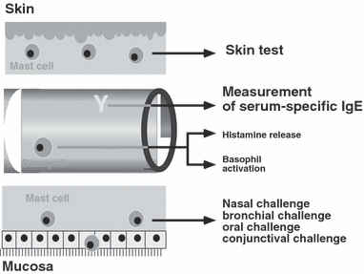
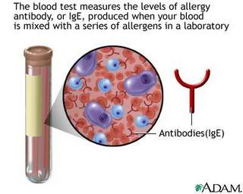
Demonstration of IgE allergy

Slide 17
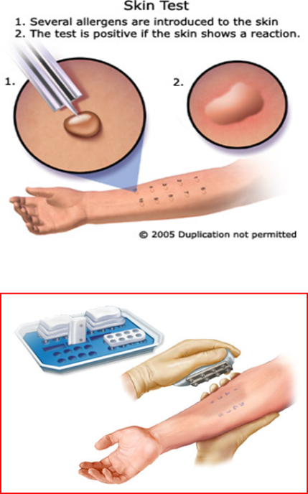
Immunoassay vs Skin Test for Diagnosis of Allergy
Immunoassay
Not influenced by medication
Not influenced by skin disease
Does not require expertise
Quality control possible
Expensive
Skin test
Higher sensitivity
Immediate results
Requires expertise
Cheaper

Slide 18
ARIA workshop: Therapeutic options
Allergen avoidance
indicated when possible
Pharmacotherapy
Safety, effectiveness
easy to be administered
Immunotherapy
Specialist Rx, may alter the natural course of the disease
costs
Patient's education
always indicated

Slide 19
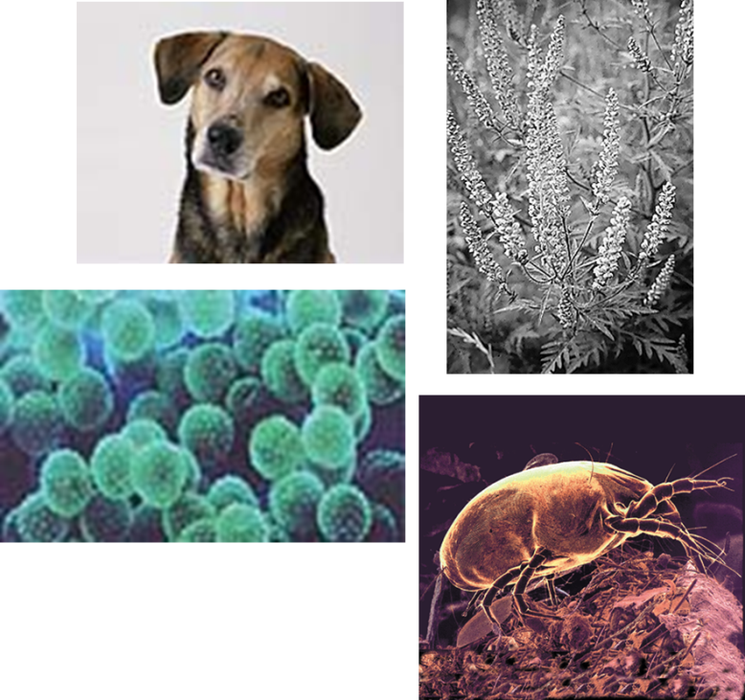
Environmental Control
1. Allergens
House dust mites
Pets
Cockroaches
Molds
Pollen
2. Pollutants and Irritants

Slide 20
House dust mite allergen avoidance
  Provide adequate ventilation to decrease humidity
  Wash bedding regularly at 60°C
  Encase pillow, mattress and quilt in allergen impermeable covers
  Use vacuum cleaner with HEPA filter
  Dispose of feather bedding
  Remove carpets
  Remove curtains, pets and stuffed toys from bedroom

Slide 21
Allergen Avoidance
Pets
    Remove pets from bedrooms and, even better, from the entire home
    Vacuum carpets, mattresses and upholstery regularly
    Wash pets regularly (±)
Molds
    Ensure dry indoor conditions
    Use ammonia to remove mold from bathrooms and other wet spaces
Cockroaches
    Eradicate cockroaches with appropriate gel-type, non-volatile, insecticides
    Eliminate dampness, cracks in floors, ceilings, cover food; wash surfaces, fabrics to remove allergen
Pollen
    Remain indoors with windows closed at peak pollen times
    Wear sunglasses
    Use air-conditioning, where possible
    Install car pollen filter

Slide 22
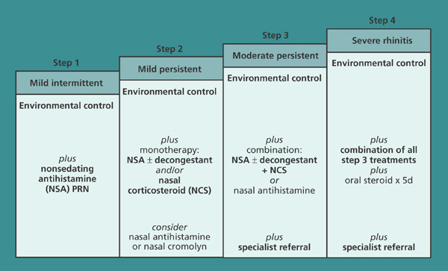
Allergic Rhinitis: Medical Treatment

Slide 23
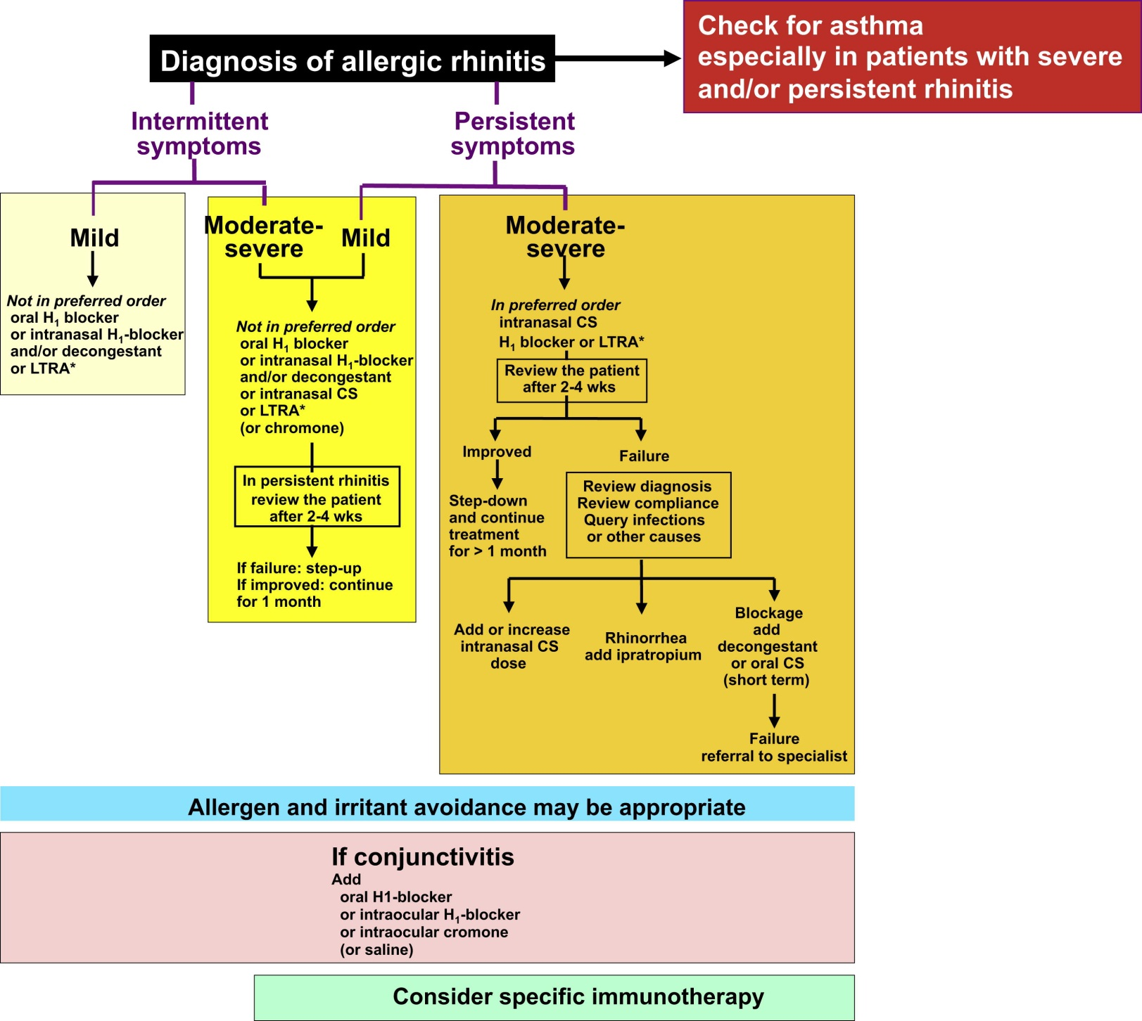
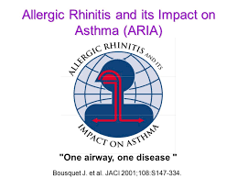

Slide 24
Medications of allergic rhinitis
sneezing rhinorrhea nasal nasal eye obstruction itch symptoms
H1-antihistamines
oral +++ +++ 0 to + +++ ++
intranasal ++ +++ + ++ 0
intraocular 0 0 0 0 +++
Corticosteroids +++ +++ ++ ++ +
Chromones
intranasal + + + + 0
intraocular 0 0 0 0 ++
Decongestants
intranasal 0 0 ++ 0 0
oral 0 0 + 0 0
Anti-cholinergics 0 +++ 0 0 0
Anti-leukotrienes + ++ ++ ? ++

Slide 25
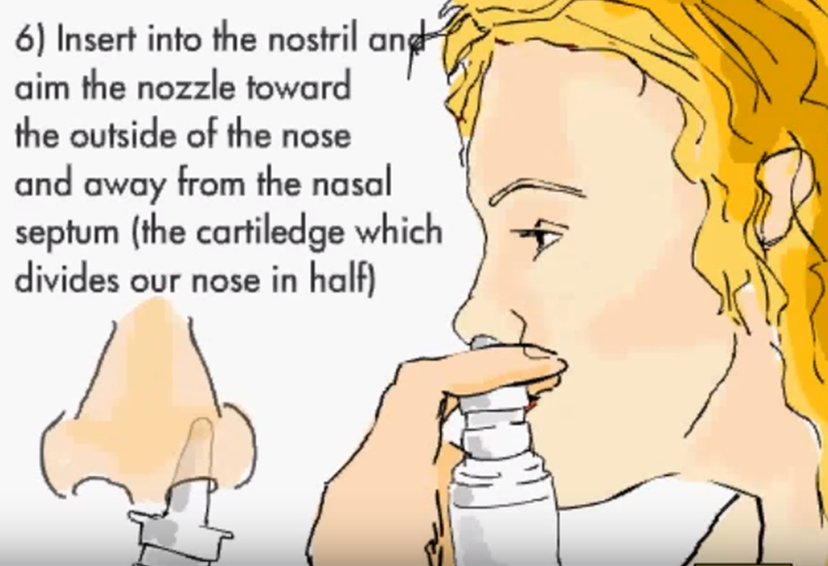
Medications of allergic rhinitis

