Slide 1

Anaphylaxis
Doç Dr H.Tekin Nacaroğlu
Nacaroğlu
Çocuk İmmünolojisi ve

Slide 2
Definition of Anaphylaxis
Anaphylaxis is a serious, life-threatening generalized or systemic hypersensitivity reaction and a serious allergic reaction that is rapid in onset and can be fatal.
Systemic
life-threatening
Acute
Notes:
-Ani başlangıçlı, yaşamı tehdit eden, sistemik aşırı duyarlılık reaksiyonu
-Ani başlangıçlı, yaşamı tehdit eden, sistemik aşırı duyarlılık reaksiyonu
-

Slide 3
Historical Background
ana- backward phylaxis- protection
Portier and Richet: reactions in dogs exposed to sea anenome toxin
First documented case: Egyptian pharoah 2640 B.C. dies after wasp sting

Slide 4
Anaphylaxis Epidemiology
84,000 cases/year in US
  1% fatal
  Kids > adults
Food Allergy
  under 4 y/o: 6-8%
  After 10 y/o: 2%
  29,000 cases food induced anaphylaxis/year
    2000 hospitalizations
    150 deaths; high association with asthma, peanut/tree nut allergy
  Peanuts are # 1 and increasing in Western nations

Slide 5
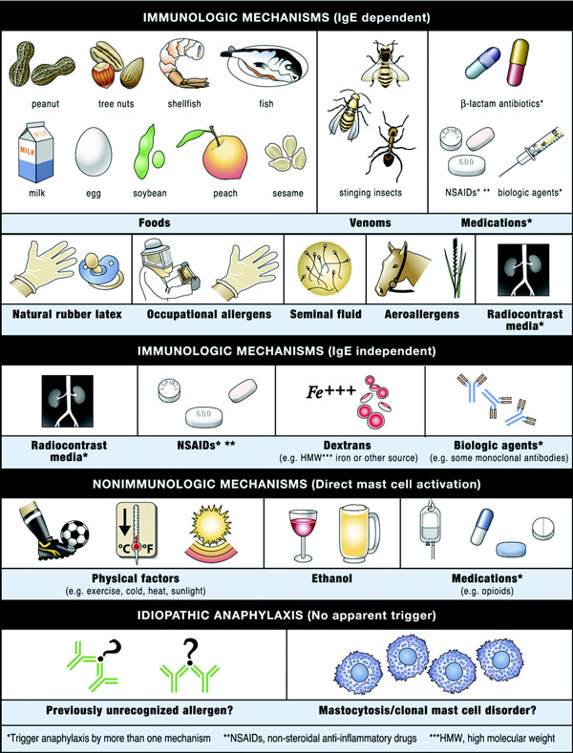

Anaphylaxis mechanisms and triggers
Notes:
Besinler * çocuklarda en sık neden, İlaçlar * yetişkinlerde en sık neden
Süt, yumurta türkiyede en sık neden olan besin
Yer fıstığı* ABD çocuklarda en sık neden olan besin
Balık, kabuklu deniz ürünleri* erişkinlerde en sık neden olan gıda

Slide 6
IMMUNOLOGICAL MECHANISMS OF ANAPHYLAXIS
.
IgE-mediated | Foods, some drugs eg penicillin, insulin, insect venom, latex, biologicals eg allergy serum
Direct mast cell degranulation | Radiocontrast material, tubocurarine, dextran, opiates eg codeine
Complement activation | Incompatible drug transfusion ( type II hypersensitivity), tissue plasminogen activator

Slide 7
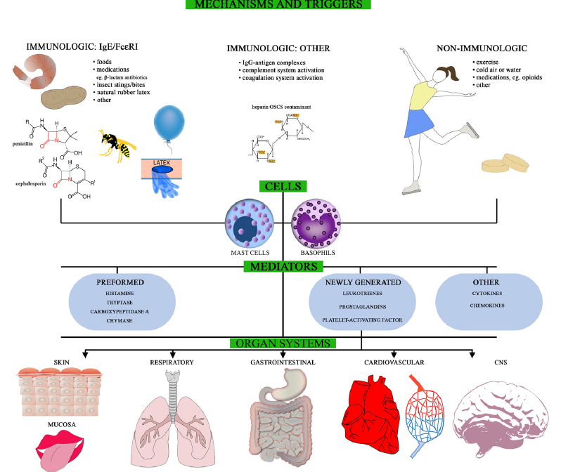
IMMUNOLOGICAL MECHANISMS
Notes:
HİSTAMİN
Anafilakside en önemli mediatör
Mast hücre ve bazofiller
H1 ve H2 histamin reseptörleri
Vazodilatasyon
Vasküler permeabilite artışı
Bronkospazm
Mukus salgısında artış
İntestinal motilitede artış
Kalp hızında artış
PAF (Platelet aktive edici faktör)
Mast hücrelerinden sentezlenir
Venüler dilatasyon yapma yeteneği ve damar geçirgenliğini artırmada histaminden daha güçlüdür
Eozinofiller için güçlü kemotaktik faktördür

Slide 8
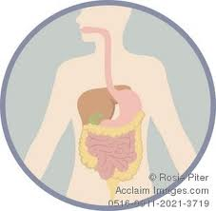
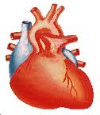


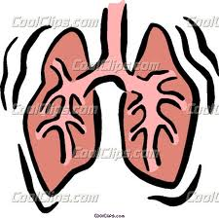
MECHANISMS
Trigger
mast cells and basophils
histamine
prostaglandins
platelet activating factor
tryptase

Slide 9
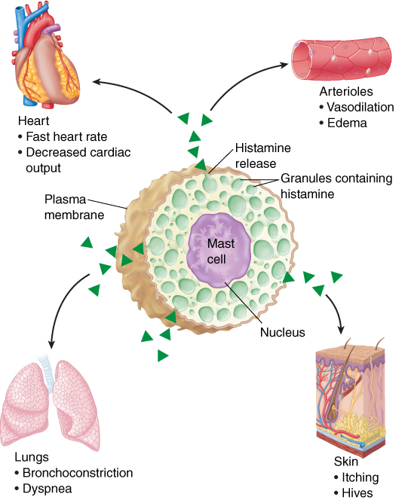
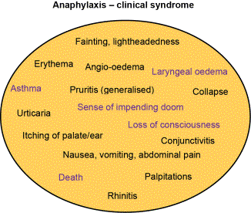
Notes:
Belirti ve bulgular genelde 5-30 dk. içinde ortaya çıkar
Başlangıç ne kadar hızlıysa genel olarak seyir o kadar ciddi olur.

Slide 10
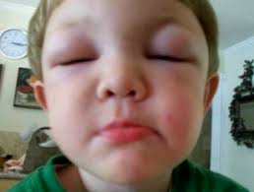
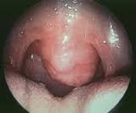
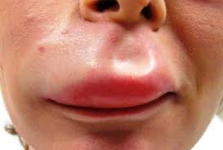
Skin, subcutaneous tissue, and mucosa (%80-90)
Flushing, itching, urticaria (hives), angioedema, morbilliform rash, pilor erection
Periorbital itching, erythema and edema, conjuncitval erythema, tearing
Itching of lips, tongue, palate, and external auditory canals; and swelling of lips, tongue, and uvula

Slide 11
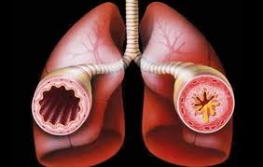
Respiratory (%70)
Nasal itching, congestion, rhinorrhea, sneezing
Throat itching and tightness, dysphonia, hoarseness, stridor, dry staccato cough
Lower airways: increased respiratory rate, shortness of breath, chest tightness, deep cough, wheezing/bronchospasm, decreased peak expiratory flow
Cyanosis
Respiratory arrest

Slide 12
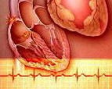
Cardiovascular system (%45)
Chest pain
Tachycardia, bradycardia (less common), other arrhythmias, palpitations
Hypotension, feeling faint, urinary or fecal incontinence, shock
Cardiac arrest

Slide 13
Gastrointestinal (%45)
Abdominal pain,
nausea,
vomiting (stringy mucus),
diarrhea,
dysphagia

Slide 14
Central nervous system (%15)
Aura of impending doom,
uneasiness (in infants and children, sudden behavioral change, eg. irritability, cessation of play, clinging to parent);
throbbing headache (pre-epinephrine), altered mental status, dizziness, confusion, tunnel vision

Slide 15
Anaphylaxis is highly likely when any ONE of the following 3 criteria is fulfilled:
1. Acute onset of an illness (minutes to several hours) with involvement of the skin, mucosal tissue, or both (eg, generalized hives, pruritus or flushing, swollen lips-tongue-uvula)
AND AT LEAST ONE OF THE FOLLOWING
A. Respiratory compromise (eg, dyspnea, wheeze-bronchospasm, reduced PEF in older children and adults, stridor, hypoxemia)
B. Reduced BP* or associated symptoms of end-organ dysfunction (eg, hypotonia, collapse, syncope, incontinence)

Slide 16
2. TWO OR MORE OF THE FOLLOWING that occur rapidly after exposure to a likely allergen for that patient (minutes to several hours):
A. Involvement of the skin-mucosal tissue (eg, generalized hives, itch-flush, swollen lips-tongue-uvula)
B. Respiratory compromise (eg, dyspnea, wheeze-bronchospasm, stridor, reduced PEF in older children and adults, hypoxemia)
C. Reduced BP* or associated symptoms (eg, hypotonia, collapse, syncope, incontinence)
D. Persistent gastrointestinal symptoms (eg, crampy abdominal pain, vomiting)

Slide 17
3. Reduced BP* after exposure to a known allergen for that patient (minutes to several hours):
A. Infants and children: low systolic BP (age specific)* or greater than 30 percent decrease in systolic BP
B. Adults: systolic BP of less than 90 mm Hg or greater than 30 percent decrease from that person's baseline

Slide 18
Natural history of anaphylactic reactions
Onset of reaction after exposure: seconds to several hours. Depends on
  patient’s sensitivity
  dose of allergen
  route of entry
Biphasic reactions (1 – 28 hrs)
  5-23% in adults; 6% in kids
  Food, venom, medication induced anaphylaxis
  Second reaction may be worse
Notes:
Anafilaksi yaklaşık 40 farklı semptom ve bulgunun çeşitli kombinasyonları ile karşımıza çıkabilir
Spontan düzelebilir (endojen epinefrin, anjiotensin II ve endotelinler) ya da dakikalar içinde solunum ve kardiyovasküler sistem tutulumu ile ölümle sonlanabilir
Epizodun başında bunu anlamak mümkün değildir
Hangi hastanın bifazik anaflaksi geliştireceğini öngörmek zordur, ancak atopik veya astımlı hastalar daha çok risk altındadır. (İlk reaksiyonu ağır olanlarda bifazik reaksiyon riski daha çok)

Slide 19
BIPHASIC ANAPHYLAXIS
Early signs may be deceptively mild, resolves with or without treatment; the biphasic phase then occurs and may lead to fatal outcome
Delayed epinephrine treatment or inadequate dose are risk factors
Severe initial phase may predispose to biphasic
Important to monitor in ER for 8-24 hrs after an anaphylactic reaction

Slide 20
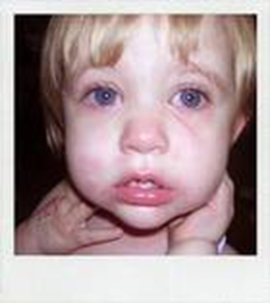
Less common lab tests
histamine vs. tryptase level
  transient
  Tryptase NOT elevated in food-induced anaphylaxis
RAST: measures specific IgE,
  less sensitive than skin prick
  Useful in pt.s who can’t d/c antihistamines or w/skin condition

Slide 21
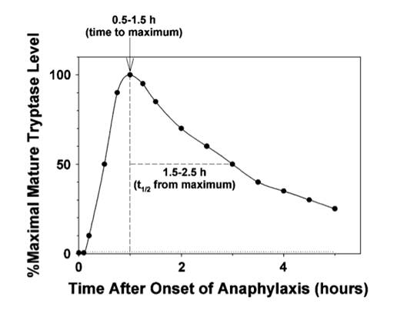
lab tests
Notes:
Serum ya da plazma triptaz
Semptomların başlamasından 15 dk ile 3 saat sonra
Plazma histamin
semptomların başlamasından 5-60 dk sonra
Kan örnekleri semptomlardan hemen sonra alınmalıdır!

Slide 22
Differential Diagnosis
Vasovagal vs. Anaphylaxis
Vasovagal
  pallor
  diaphoresis
  bradycardia or NSR
Anaphylaxis
  tachycardia
  flushing
  urticaria/pruritis/ bronchospasm

Slide 23
GENERAL MANAGEMENT OF ANAPHYLAXIS
Airway
Breathing
Circulation
But use epinephrine promptly
Notes:
You need to know the general principles of anaphylaxis management, but not drug doses at this stage

Slide 24
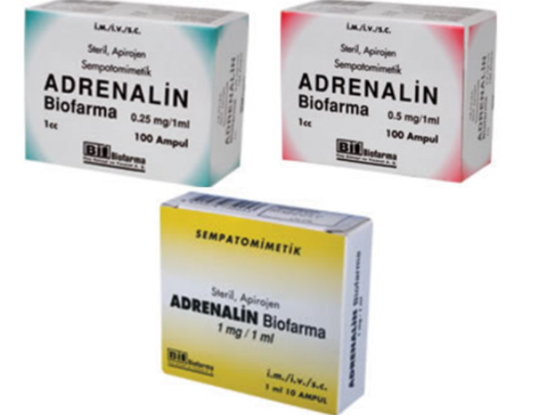
Management of anaphylaxis: Initial
Epinephrine 0.01mg/kg (max 0.5mg) IM X3, every 5-20min as needed. In severe cases epinephrine IV
H1 antagonists eg Diphenhydramine 25-100mg
H2 antagonists eg cimetidine
IV fluids to maintain venous access and circulation
Oxygen
Corticosteroids

Slide 25
Management of anaphylaxis: Bronchospasm
Inhaled bronchodilators eg salbutamol. IV if unresponsive to inhaled
Oxygen
Intubation and ventilation if needed

Slide 26
Management of anaphylaxis: Hypotension
Trendelenberg position
Volume expansion with crystalloid
Vasopressors eg dopamine, norepinephrine, metaraminol, vasopressin
Glucagon esp if on beta-blocker

Slide 27
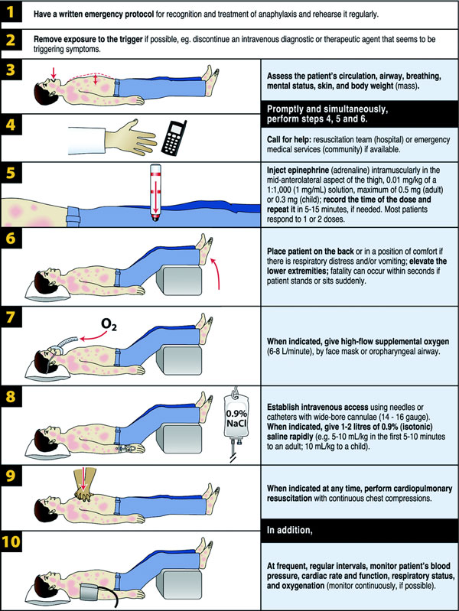
Treatment

Slide 28
Treatment
Removal of the causing agent
Epinephrine
  0.3 – 0.5 mg (0.01mg/kg) i.m. (vastus lateralis), repeat 5 – 15 minutes
  i.v. – titrate the dose
Oxygen
Intubate, if stridor or arrest
Trendelenburg position
i. v. Fluids (cristalloids vs. colloids?)
  Steroides, antihistamines, inhaled beta agonists, glucagon of secondary (and questionable) importance

Slide 29

Prevention
An Auto-injector is prescribed according to the child’s weight to deliver a single dose of adrenaline and reverse the symptoms of anaphylaxis.
Accessible at all times during the school day – NOT in a locked room or cupboard.
Contains completed care plan with medication in date.
Avoid extremes of temperature

Slide 30
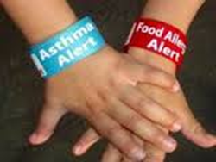
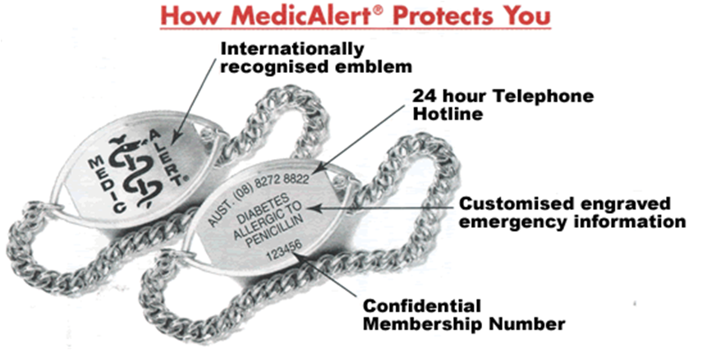
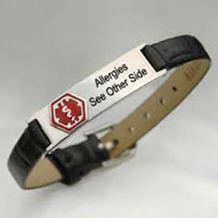
Prevention
Clearly labelled with child’s name and passport photo for clear identification.

Slide 32
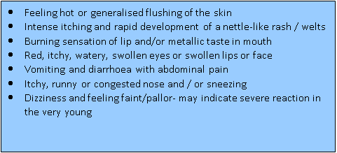
Name:_________
Date of Birth:______
Minor reaction
Known severe allergies
___________
  Keep calm, stay with pupil and call for help
  Give prescribed medication e.g. Piriton
  if asthmatic give 4-6 puffs of reliever (blue) inhaler
  Record medication administered and the time it is given
  Locate pupil’s prescribed auto-injector
  Contact parent or carer

Slide 33


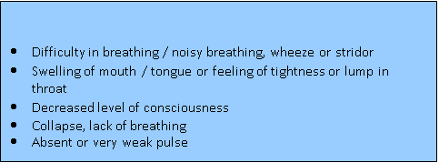

Slide 34




Form fist around Auto-injector and pull off BLUE cap (JEXT YELLOW cap)
  Give prescribed Auto-injector & record time__________
If unconscious but breathing place in recovery position
Call paramedic ambulance 999
Contact parent / carer (contact numbers given over)
If no improvement within 5 minutes give Auto-injector & record time_________________
If no signs of life commence CPR (cardiopulmonary resuscitation) and continue until professional help arrives
Used Auto-injector accompanies child to hospital
IF IN DOUBT GIVE AUTO-INJECTOR
Hold Auto-injector 10cm away from outer thigh. ORANGE (JEXT BLACK) tip should point towards outer thigh through clothing if necessary.
Jab firmly into outer thigh so that autoinjector is at right angle to outer thigh until a click is heard and hold in place for 10 seconds.
Remove Auto-injector and massage the injection site for 10 seconds. Used Auto-injector accompanies child to hospital

Slide 35


Slide 36
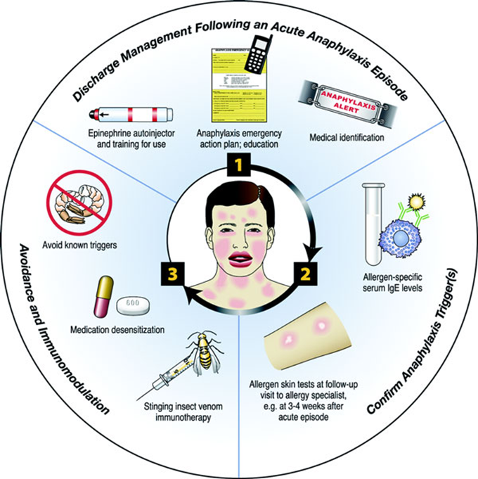
Summary:
Various mechanisms and presentations
May resemble common illnesses
Early recognition and treatment
Prevention is critical

