Slide 1
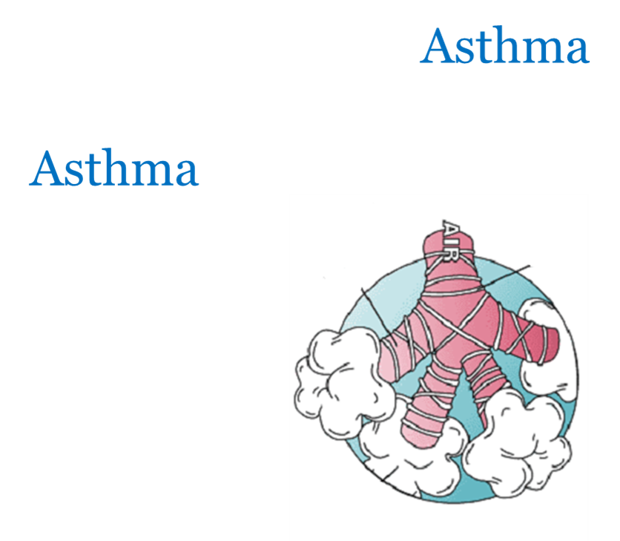
Asthma
Asthma
Asthma
Doç Dr H.Tekin Nacaroğlu
Çocuk İmmünolojisi ve Allerji Hastalıkları

Slide 2
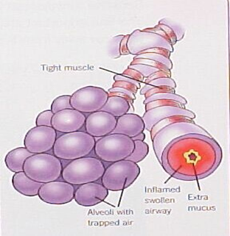
Definition of asthma
Asthma is a heterogeneous disease, usually characterized by chronic airway inflammation.
It is defined by the history of respiratory symptoms such as wheeze, shortness of breath, chest tightness and cough that vary over time and in intensity, together with variable expiratory airflow limitation.

Slide 3
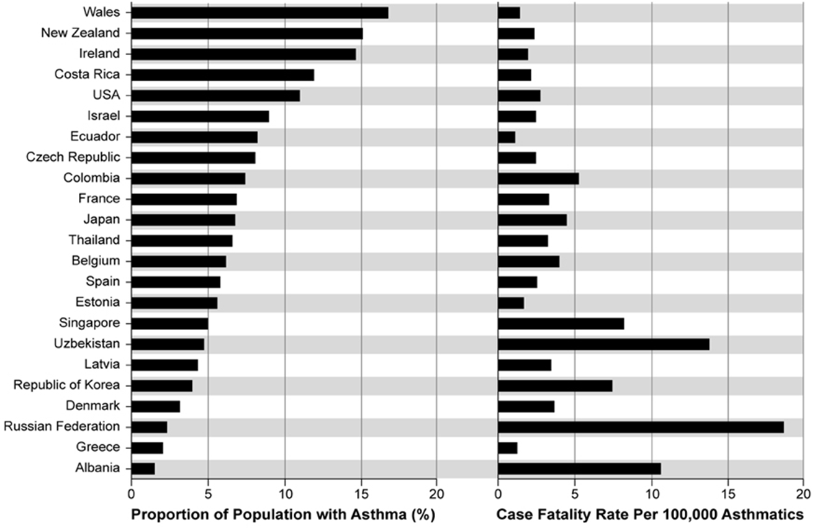
Notes:
Türkiye; Çocuk %5-10

Slide 4
G IN A
lobal
itiative for
sthma
© Global Initiative for Asthma

Slide 5
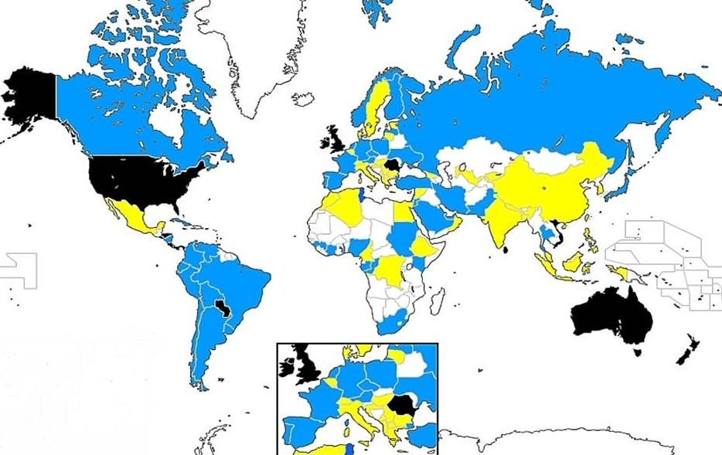
Prevalence of asthma in children aged 13-14 years
© Global Initiative for Asthma
GINA 2017

Slide 6
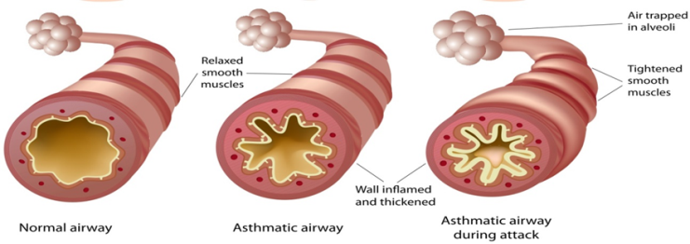
Mechanisms: Asthma Inflammation
Inducers
Allergens, chemical sensitizers
Air pollution, viruses, occupational exposures
Inflammation
Airway
Hyperresponsiveness
Airflow Limitation
Triggers
Allergens, exercise, cold air, SO₂
particulates
Symptoms
Cough, Wheeze, Chest tightness
Dyspnea

Slide 7
Airway pathology in asthma
Notes:
This is the result of chronic inflammation – the airway appears like a chronic wound – think of it like a leg ulcer – hypertrophied, hyper-sensitive, mucousy

Slide 8
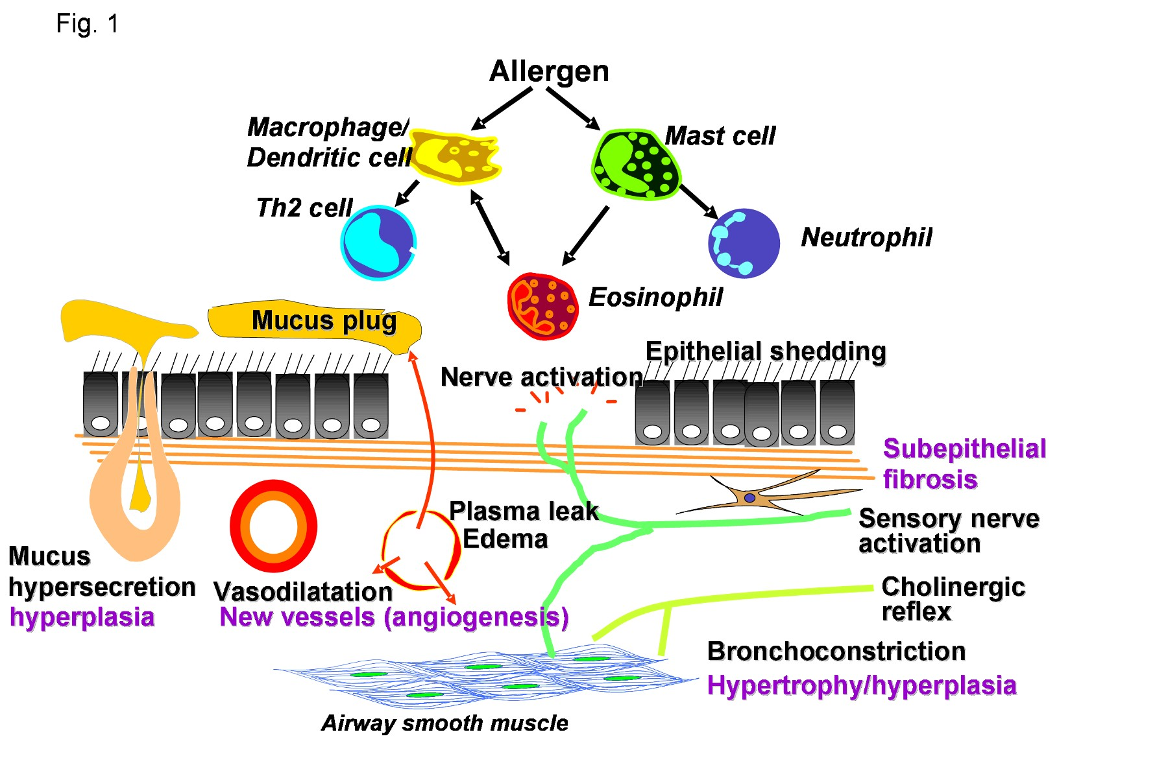
Asthma Inflammation: Cells and Mediators
Source: Peter J. Barnes, MD

Slide 9
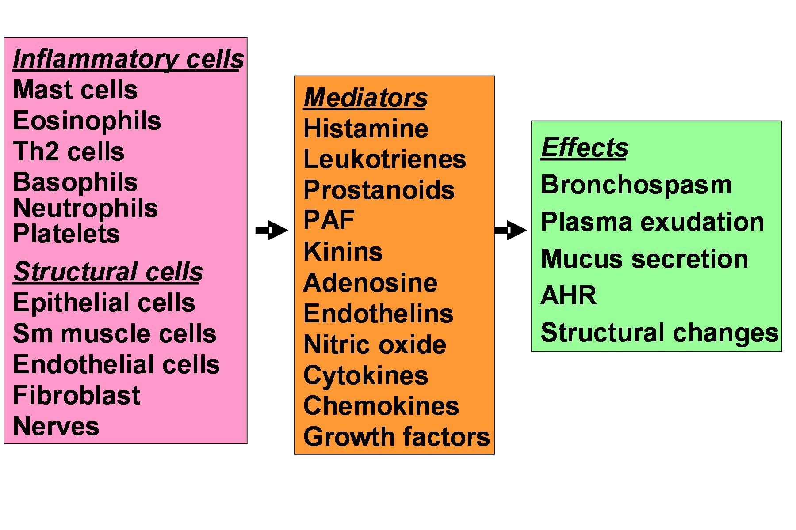
Asthma Inflammation: Cells and Mediators
Source: Peter J. Barnes, MD

Slide 10
Diagnosis of asthma
The diagnosis of asthma should be based on:
A history of characteristic symptom patterns
Evidence of variable airflow limitation, from bronchodilator reversibility testing or other tests
Document evidence for the diagnosis in the patient’s notes, preferably before starting controller treatment
It is often more difficult to confirm the diagnosis after treatment has been started
Asthma is usually characterized by airway inflammation and airway hyperresponsiveness, but these are not necessary or sufficient to make the diagnosis of asthma.
GINA 2017

Slide 11
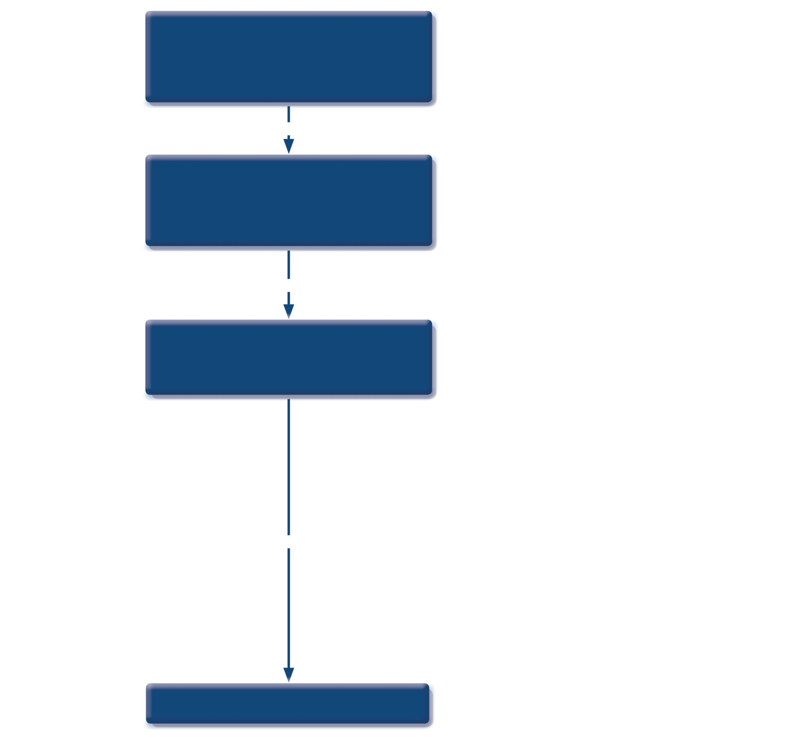
Patient with respiratory symptoms
Are the symptoms typical of asthma?
YES
Detailed history/examination for asthma
History/examination supports asthma diagnosis?
YES
Perform spirometry/PEF with reversibility test
Results support asthma diagnosis?
YES
Treat for ASTHMA
GINA 2017
© Global Initiative for Asthma

Slide 12
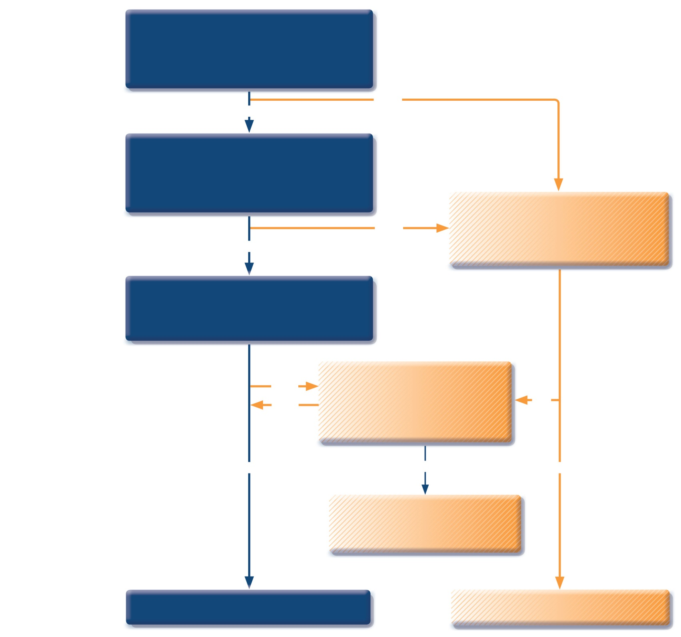
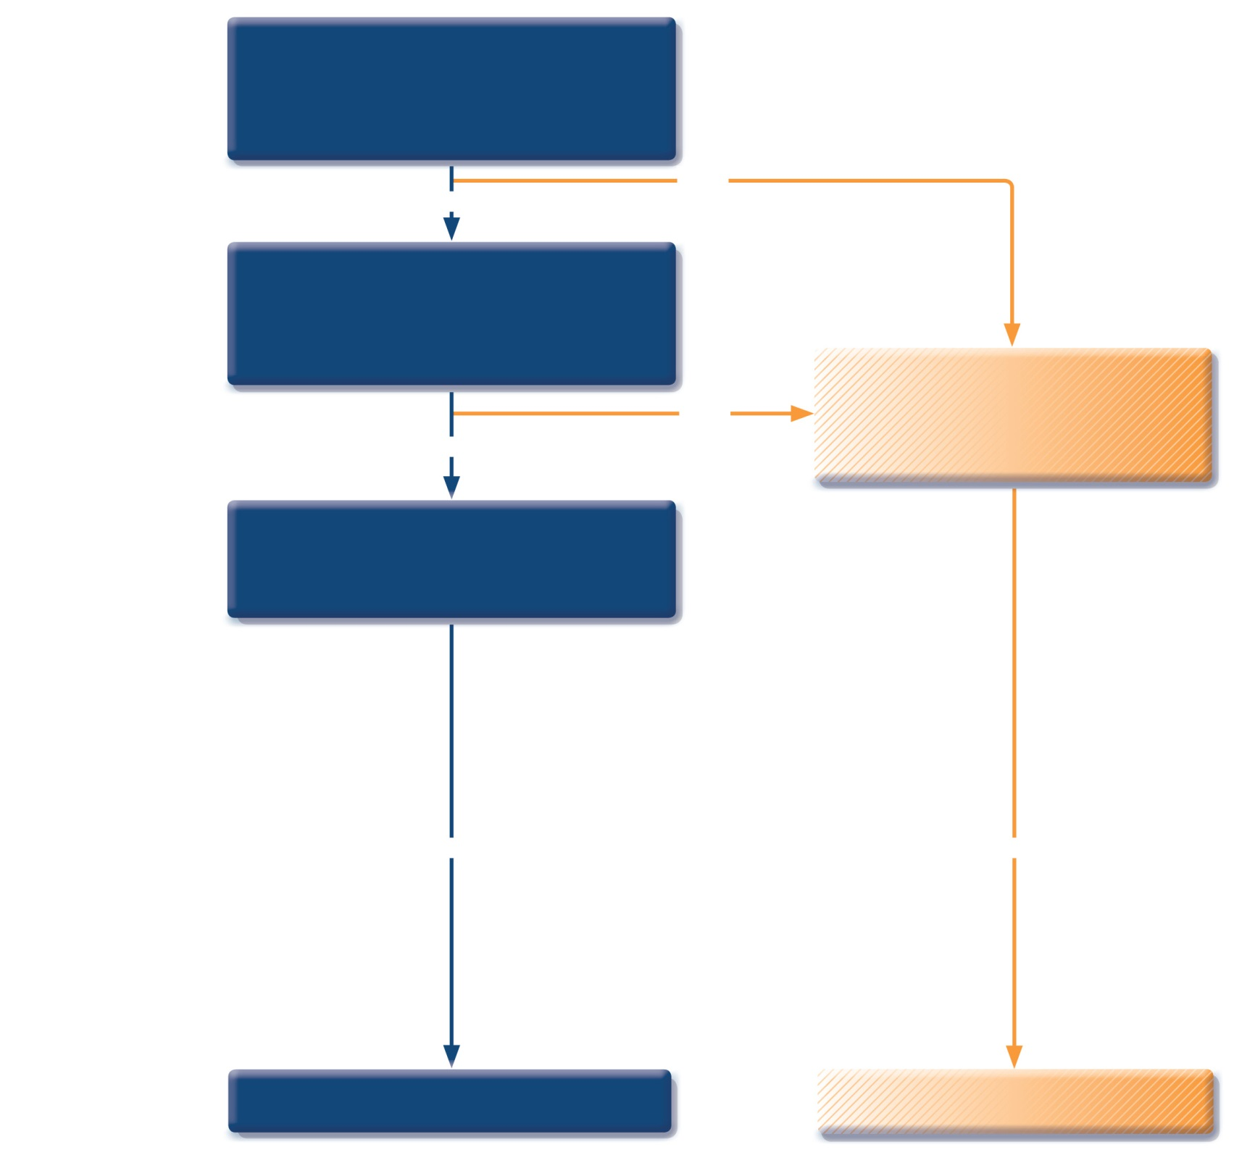
Patient with respiratory symptoms
Are the symptoms typical of asthma?
YES
NO
Detailed history/examination for asthma
History/examination supports asthma diagnosis?
Further history and tests for alternative diagnoses
Alternative diagnosis confirmed?
NO
YES
Perform spirometry/PEF with reversibility test
Results support asthma diagnosis?
YES
YES
Treat for ASTHMA
Treat for alternative diagnosis
GINA 2017
© Global Initiative for Asthma

Slide 13
Patient with respiratory symptoms
Are the symptoms typical of asthma?
YES
NO
Detailed history/examination for asthma
History/examination supports asthma diagnosis?
Further history and tests for alternative diagnoses
Alternative diagnosis confirmed?
NO
YES
Perform spirometry/PEF with reversibility test
Results support asthma diagnosis?
Repeat on another occasion or arrange other tests
Confirms asthma diagnosis?
NO
YES
NO
YES
NO
YES
Consider trial of treatment for most likely diagnosis, or refer for further investigations
Treat for ASTHMA
Treat for alternative diagnosis
GINA 2017
© Global Initiative for Asthma

Slide 14
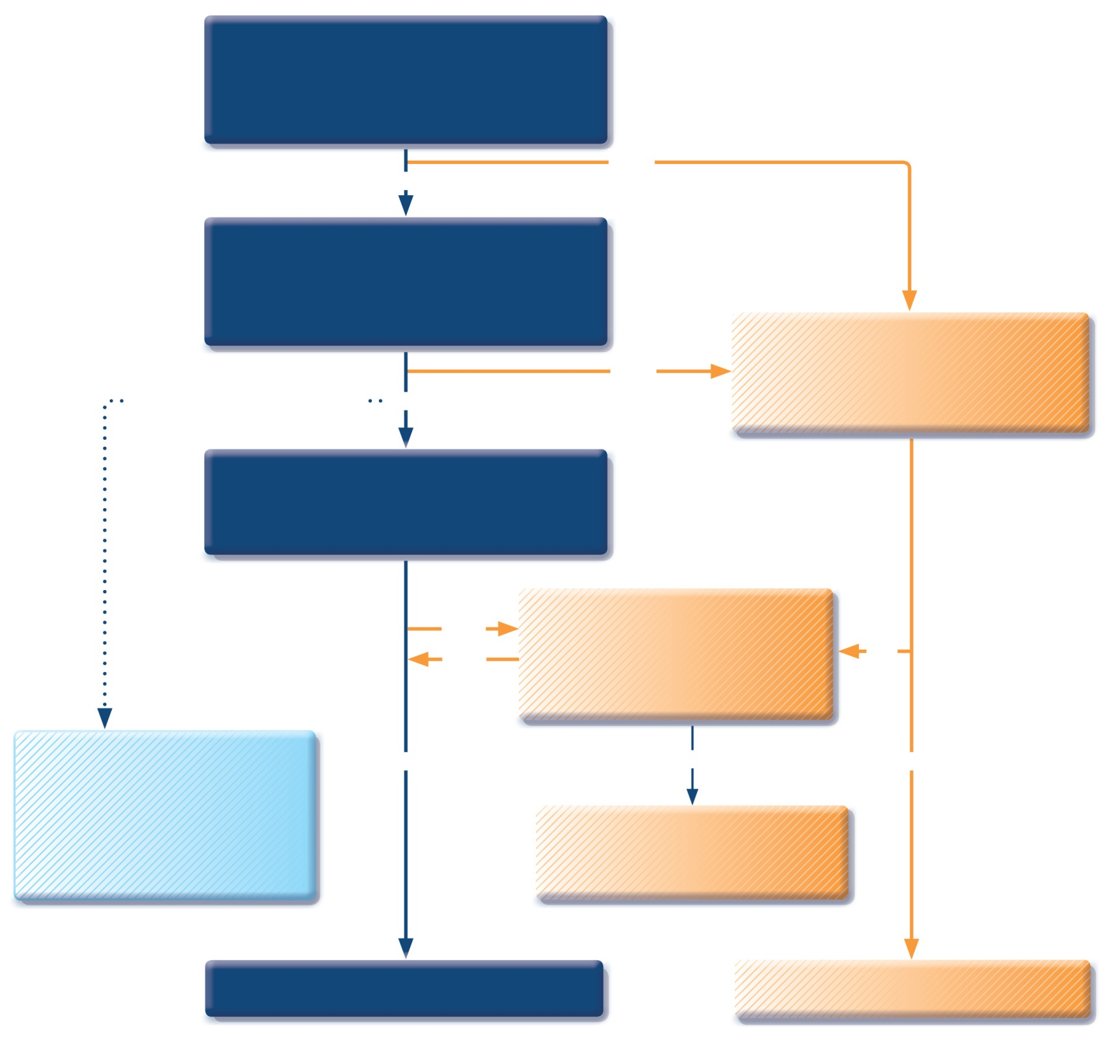
Patient with respiratory symptoms
Are the symptoms typical of asthma?
YES
NO
Detailed history/examination for asthma
History/examination supports asthma diagnosis?
Further history and tests for alternative diagnoses
Alternative diagnosis confirmed?
Clinical urgency, and other diagnoses unlikely
NO
YES
Perform spirometry/PEF with reversibility test
Results support asthma diagnosis?
Repeat on another occasion or arrange other tests
Confirms asthma diagnosis?
NO
YES
NO
Empiric treatment with ICS and prn SABA
Review response
Diagnostic testing within 1-3 months
YES
NO
YES
Consider trial of treatment for most likely diagnosis, or refer for further investigations
Treat for ASTHMA
Treat for alternative diagnosis
GINA 2017)
© Global Initiative for Asthma

Slide 15
Diagnosis of asthma – symptoms
Increased probability that symptoms are due to asthma if:
More than one type of symptom (wheeze, shortness of breath, cough, chest tightness)
Symptoms often worse at night or in the early morning
Symptoms vary over time and in intensity
Symptoms are triggered by viral infections, exercise, allergen exposure, changes in weather, laughter, irritants such as car exhaust fumes, smoke, or strong smells
Decreased probability that symptoms are due to asthma if:
Isolated cough with no other respiratory symptoms
Chronic production of sputum
Shortness of breath associated with dizziness, light-headedness or peripheral tingling
Chest pain
Exercise-induced dyspnea with noisy inspiration (stridor)
GINA 2017

Slide 16
Features suggesting asthma
UPDATED 2017
Feature | Characteristics suggesting asthma
Cough | Recurrent or persistent non-productive cough that may be worse at night or accompanied by some wheezing and breathing difficulties. Cough occurring with exercise, laughing, crying or exposure to tobacco smoke in the absence of an apparent respiratory infection Prolonged cough in infancy, and cough without cold symptoms, are associated with later parent-reported physician-diagnosed asthma, independent of infant wheeze
Wheezing | Recurrent wheezing, including during sleep or with triggers such as activity, laughing, crying or exposure to tobacco smoke or air pollution
Difficult or heavy breathing or shortness of breath | Occurring with exercise, laughing, or crying
Reduced activity | Not running, playing or laughing at the same intensity as other children; tires earlier during walks (wants to be carried)
Past or family history | Other allergic disease (atopic dermatitis or allergic rhinitis) Asthma in first-degree relatives
Therapeutic trial with low dose ICS and as-needed SABA | Clinical improvement during 2–3 months of controller treatment and worsening when treatment is stopped
GINA 2017, Box 6-2

Slide 17
Diagnosis of asthma Physical examination
It is about exacerbations of the disease.
Normal breath sound as well as expiratory or inspiratory rhonchi
Silent lung, hiperinflation, cyanosis, tachycardia, usage of supporting breath muscles

Slide 18
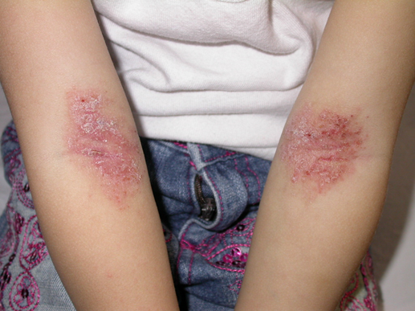
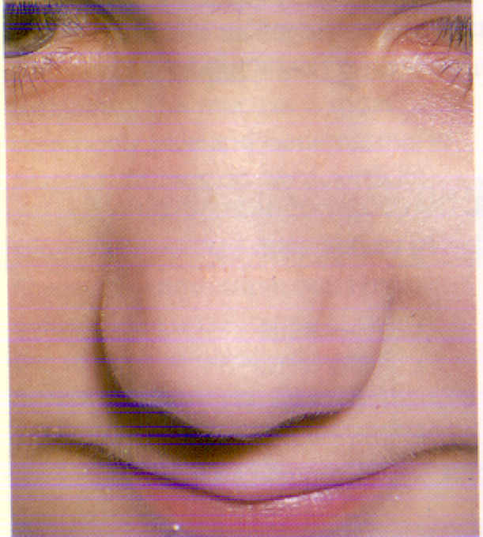
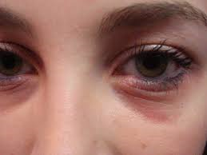
Physical examination

Slide 19
Diagnosis of asthma
Determination of atopy
Eosinophils
IgE, RAST: measures specific IgE,
Skin Prick Test

Slide 20
Diagnosis of asthma
Eosinophils
EOS >%4, absolute number of eosinophils>450 mm3
Not specific for asthma.
Eosinophilia in sputum and nasal secretion supports asthma.
Evaluating blood, sputum or nasal secretion eosinophilia levels are not rutin.

Slide 21
Diagnosis of asthma
RAST: measures specific IgE
less sensitive than skin prick
More expensive
Useful in pt.s who can’t d/c antihistamines or w/skin condition

Slide 22
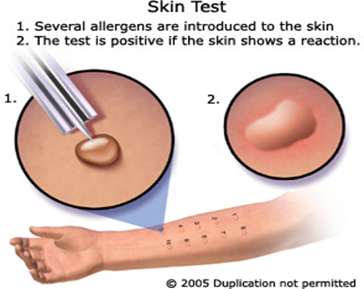
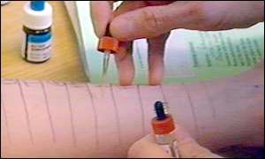
Diagnosis of asthma
Skin Prick Test
Cheap
Quickly
Reliable

Slide 23
Diagnosis of asthma – variable airflow limitation
Confirm presence of airflow limitation
Document that FEV₁/FVC is reduced (at least once, when FEV₁ is low)
FEV₁/ FVC ratio is normally >0.75 – 0.80 in healthy adults, and >0.90 in children
Confirm variation in lung function is greater than in healthy individuals
The greater the variation, or the more times variation is seen, the greater probability that the diagnosis is asthma
Excessive bronchodilator reversibility (adults: increase in FEV₁ >12% and >200mL; children: increase >12% predicted)
Excessive diurnal variability from 1-2 weeks’ twice-daily PEF monitoring (daily amplitude x 100/daily mean, averaged)
Significant increase in FEV₁ or PEF after 4 weeks of controller treatment
If initial testing is negative:
Repeat when patient is symptomatic, or after withholding bronchodilators
Refer for additional tests (especially children ≤5 years, or the elderly)
GINA 2017

Slide 24
Typical spirometric tracings
Flow
Volume
Normal
FEV₁
Asthma (after BD)
Normal
Asthma (before BD)
Asthma (after BD)
Asthma (before BD)
1
2
3
4
5
6
Volume
Time (seconds)
Note: Each FEV₁ represents the highest of three reproducible measurements
GINA 2017

Slide 25
Common differential diagnoses of asthma in children
Condition | Typical features
Recurrent viral respiratory infections | Mainly cough, runny congested nose for <10 days; wheeze usually mild; no symptoms between infections
Gastroesophageal reflux | Cough when feeding; recurrent chest infections; vomits easily especially after large feeds; poor response to asthma medications
Foreign body aspiration | Episode of abrupt severe cough and/or stridor during eating or play; recurrent chest infections and cough; focal lung signs
Tracheomalacia or bronchomalacia | Noisy breathing when crying or eating, or during URTIs; harsh cough; inspiratory or expiratory retraction; symptoms often present since birth; poor response to asthma treatment
Tuberculosis | Persistent noisy respirations and cough; fever unresponsive to normal antibiotics; enlarged lymph nodes; poor response to BD or ICS; contact with someone with TB
Congenital heart disease | Cardiac murmur; cyanosis when eating; failure to thrive; tachycardia; tachypnea or hepatomegaly; poor response to asthma medications

Slide 26
Common differential diagnoses of asthma in children
Condition | Typical features
Cystic fibrosis | Cough starting shortly after birth; recurrent chest infections; failure to thrive (malabsorption); loose greasy bulky stools
Primary ciliary dyskinesia | Cough and recurrent mild chest infections; chronic ear infections and purulent nasal discharge; poor response to asthma medications; situs inversus (in ~50% children with this condition)
Vascular ring | Respirations often persistently noisy; poor response to asthma medications
Bronchopulmonary dysplasia | Infant born prematurely; very low birth weight; needed prolonged mechanical ventilation or supplemental oxygen; difficulty with breathing present from birth
Immune deficiency | Recurrent fever and infections (including non-respiratory); failure to thrive
GINA 2017

Slide 27
When do we think asthma?
Symptoms at neonatal age
Cyanosis with feeding
Vomiting with feeding
Growth reterdation
Persistant suppurative cough
Stridor
Chest deformity
Clubbing finger
Local or persistant auscultation findings
Local or persistant radiologic findings

Slide 28
Asthma Treatment
Goals of asthma management
Asthma Drug Therapy
Children ≤5 years Asthma Treatment
Children >5 years Asthma Treatment

Slide 29
Goals of asthma management
The long-term goals of asthma management are
Symptom control: to achieve good control of symptoms and maintain normal activity levels
Risk reduction: to minimize future risk of exacerbations, fixed airflow limitation and medication side-effects
Achieving these goals requires a partnership between patient and their health care providers
Ask the patient about their own goals regarding their asthma
Good communication strategies are essential
Consider the health care system, medication availability, cultural and personal preferences and health literacy
GINA 2017

Slide 30
Asthma Drug Therapy
Bronchodilators
Inhaled glucocorticosteroids
Leukotriene receptor antagonist (LTRA)

Slide 31
Bronchodilators
SABA - short acting beta agonist
It is the most effective bronchodilator and therefore the first choice treatment for acute asthma treatment in all age groups.
LABA - long acting beta agonist
It should not be used alone in therapy, but should be combined with inhaled steroids to reduce the dose of inhaled steroid.
It should be debated whether it is safe for young children.
Ipratropium
Inhaler anticholinergics are not recommended for long-term treatment of pediatric asthma.

Slide 32
Inhaled glucocorticosteroids
The most effective controlling drug
Reduce asthma attacks
Reduce bronchial hyperreactivity
Improve symptom score

Slide 33
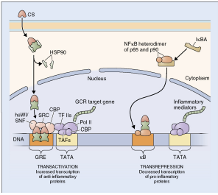
Inhaled glucocorticosteroids
They may inhibit the synthesis, release and expression of cytokines, inflammatory peptides, chemokines, growth factors, adhesion molecules and lipid mediators involved in the inflammatory response

Slide 34
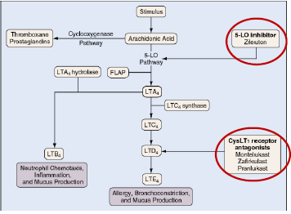
Leukotriene receptor antagonist (LTRA)
Leukotrienes cause bronchospasm, increased mucus secretion and airway edema.
LTRA effects by binding to the Cys LT1 receptor

Slide 35
Treating to control symptoms and minimize risk
Establish a patient-doctor partnership
Manage asthma in a continuous cycle:
Assess
Adjust treatment (pharmacological and non-pharmacological)
Review the response
Teach and reinforce essential skills
Inhaler skills
Adherence
Guided self-management education
Written asthma action plan
Self-monitoring
Regular medical review
ASSESS
REVIEW RESPONSE
ADJUST TREATMENT
GINA 2017

Slide 36
The control-based asthma management cycle
Diagnosis
Symptom control & risk factors (including lung function)
Inhaler technique & adherence
Patient preference
ASSESS
REVIEW RESPONSE
Symptoms
Exacerbations
Side-effects
Patient satisfaction
Lung function
ADJUST TREATMENT
Asthma medications
Non-pharmacological strategies
Treat modifiable risk factors
GINA 2017

Slide 37
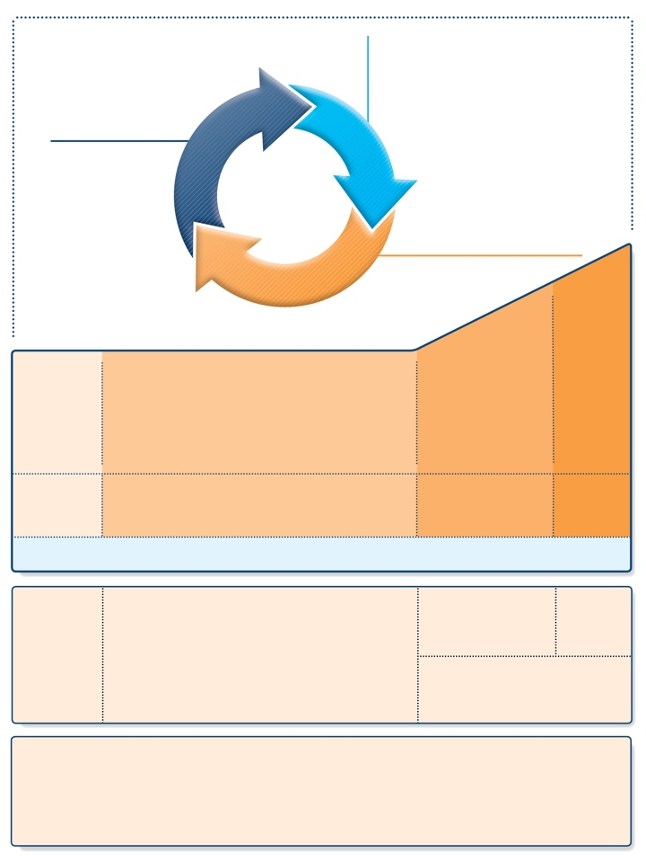
Stepwise approach to control symptoms and reduce risk (children ≤5 years)
Diagnosis
Symptom control & risk factors
Inhaler technique & adherence
Parent preference
ASSESS
REVIEW RESPONSE
Symptoms
Exacerbations
Side-effects
Parent satisfaction
ADJUST TREATMENT
Asthma medications
Non-pharmacological strategies
Treat modifiable risk factors
STEP 4
PREFERRED CONTROLLER CHOICE
STEP 1
STEP 2
STEP 3
Continue controller & refer for specialist assessment
Double ‘low dose’ ICS
Daily low dose ICS
Other controller options
Leukotriene receptor antagonist (LTRA)
Intermittent ICS
Low dose ICS + LTRA
Add LTRA
Inc. ICS frequency
Add intermitt ICS
RELIEVER
As-needed short-acting beta₂-agonist (all children)
CONSIDER THIS STEP FOR CHILDREN WITH:
Infrequent viral wheezing and no or few interval symptoms
Symptom pattern consistent with asthma and asthma symptoms not well-controlled, or ≥3 exacerbations per year
Symptom pattern not consistent with asthma but wheezing episodes occur frequently, e.g. every 6–8 weeks. Give diagnostic trial for 3 months.
Asthma diagnosis, and not well-controlled on low dose ICS
Not well- controlled on double ICS
First check diagnosis, inhaler skills, adherence, exposures
KEY ISSUES
ALL CHILDREN
• Assess symptom control, future risk, comorbidities
• Self-management: education, inhaler skills, written asthma action plan, adherence
• Regular review: assess response, adverse events, establish minimal effective treatment
• (Where relevant): environmental control for smoke, allergens, indoor/outdoor air pollution
GINA 2017

Slide 38
Stepwise approach – key issues (children ≤5 years)
UPDATED 2017
KEY ISSUES
ALL CHILDREN
• Assess symptom control, future risk, comorbidities
• Self-management: education, inhaler skills, written asthma action plan, adherence
• Regular review: assess response, adverse events, establish minimal effective treatment
• (Where relevant): environmental control for smoke, allergens, indoor/outdoor air pollution
Assess asthma control
Symptom control, future risk, comorbidities
Self-management
Education, inhaler skills, written asthma action plan, adherence
Regular review
Assess response, adverse events, establish minimal effective treatment
Record height each year, as poorly-controlled asthma may influence growth, and ICS may be associated with growth delay in first 1-2 years
Other
(Where relevant): environmental control for smoke, allergens, indoor or outdoor air pollution
GINA 2017

Slide 39
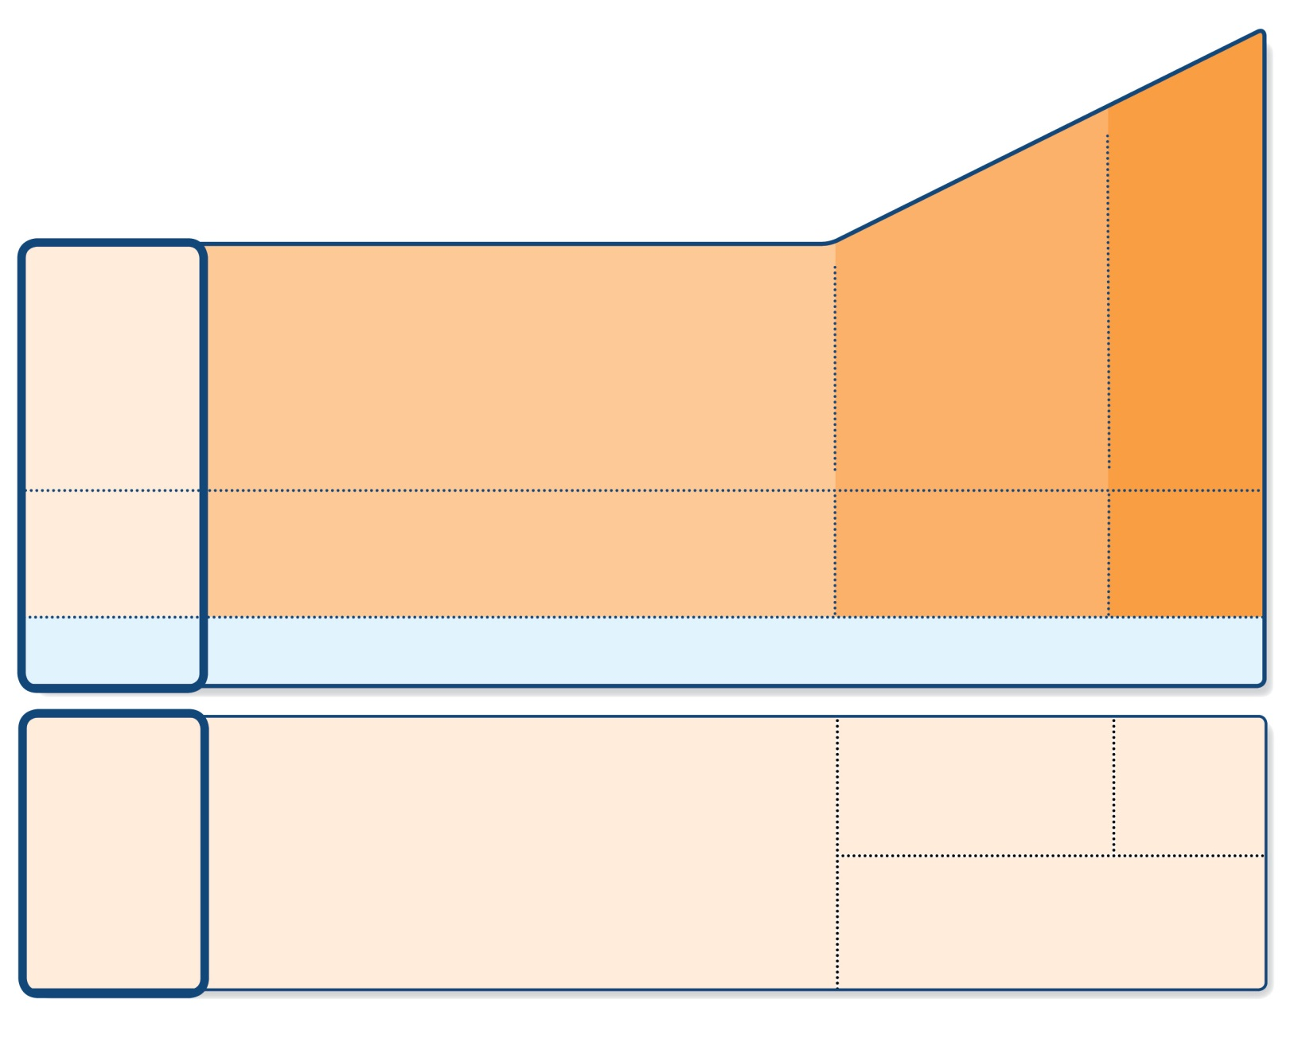
Step 1 (children ≤5 years) – as-needed inhaled SABA
STEP 4
PREFERRED CONTROLLER CHOICE
STEP 3
STEP 1
STEP 2
Continue controller & refer for specialist assessment
Double ‘low dose’ ICS
Daily low dose ICS
Other controller options
Leukotriene receptor antagonist (LTRA)
Intermittent ICS
Low dose ICS + LTRA
Add LTRA
Inc. ICS frequency
Add intermitt ICS
RELIEVER
As-needed short-acting beta₂-agonist (all children)
CONSIDER THIS STEP FOR CHILDREN WITH:
Infrequent viral wheezing and no or few interval symptoms
Symptom pattern consistent with asthma and asthma symptoms not well-controlled, or ≥3 exacerbations per year
Symptom pattern not consistent with asthma but wheezing episodes occur frequently, e.g. every 6–8 weeks. Give diagnostic trial for 3 months.
Asthma diagnosis, and not well-controlled on low dose ICS
Not well-controlled on double ICS
First check diagnosis, inhaler skills, adherence, exposures
GINA 2017

Slide 40
Step 1 (children ≤5 years) – as-needed inhaled SABA
Preferred option: as-needed inhaled SABA
Provide inhaled SABA to all children who experience wheezing episodes
Not effective in all children
Other options
Oral bronchodilator therapy is not recommended (slower onset of action, more side-effects)
For children with intermittent viral-induced wheeze and no interval symptoms, if as-needed SABA is not sufficient, consider intermittent ICS. Because of the risk of side-effects, this should only be considered if the physician is confident that the treatment will be used appropriately.
GINA 2017

Slide 41
GINA assessment of asthma control in children ≤5 years
A. Symptom control
In the past 4 weeks, has the child had: | Well-controlled | Partly controlled | Uncontrolled
Daytime asthma symptoms for more than few minutes, more than once/week? Yes No | None of these | 1-2 of these | 3-4 of these
Any activity limitation due to asthma? (runs/plays less than other children, tires easily during walks/playing) Yes No
Reliever needed* more than once a week? Yes No
Any night waking or night coughing due to asthma? Yes No
B. Risk factors for poor asthma outcomes
ASSESS CHILD’S RISK FOR: Exacerbations within the next few months Fixed airflow limitation Medication side-effects
Level of asthma symptom control
GINA 2017

Slide 42
LEVEL OF CONTROL
REDUCE
TREATMENT OF ACTION
maintain and find lowest controlling step
controlled
consider stepping up to gain control
partly controlled
uncontrolled
step up until controlled
INCREASE
exacerbation
treat as exacerbation

Slide 43
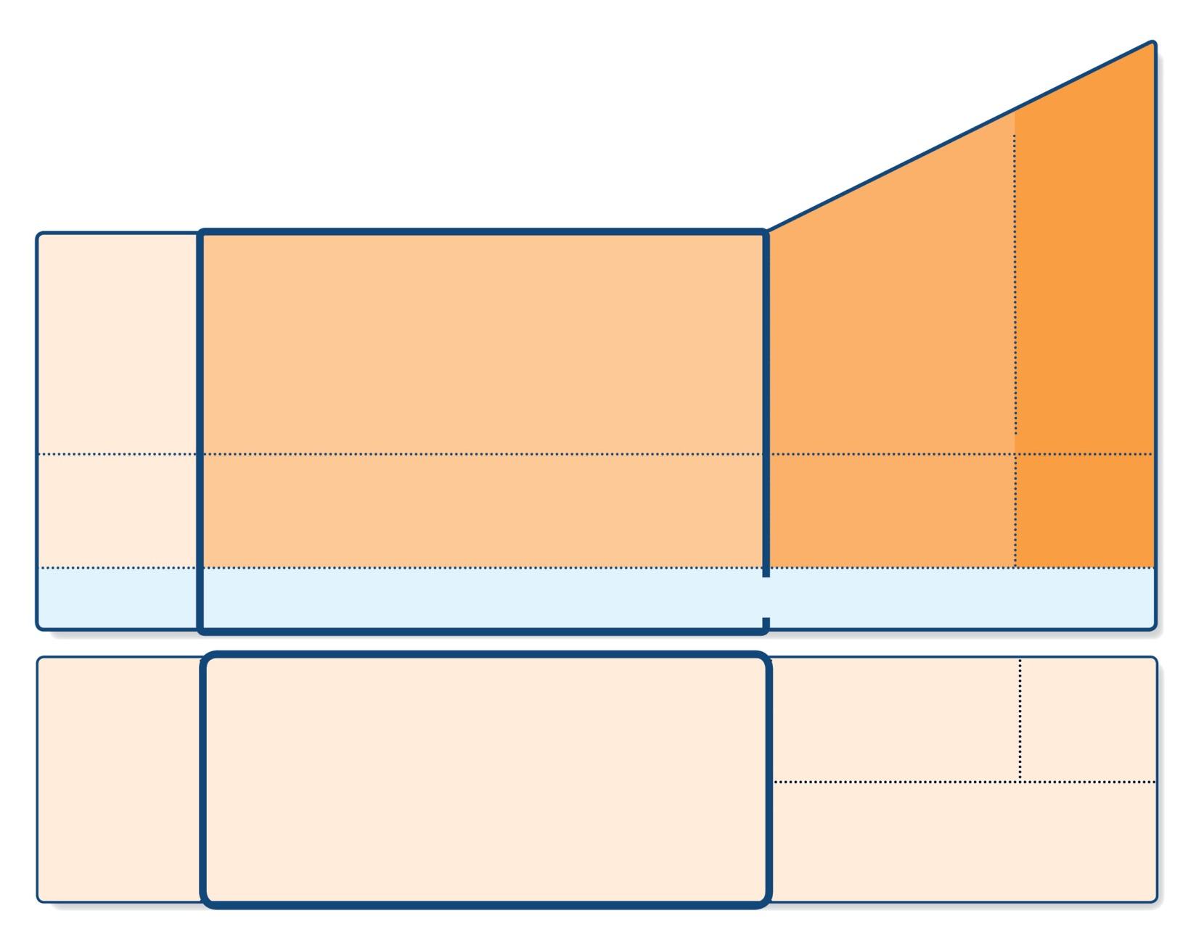
Step 2 (children ≤5 years) – initial controller + as-needed SABA
STEP 4
PREFERRED CONTROLLER CHOICE
STEP 3
STEP 1
STEP 2
Continue controller & refer for specialist assessment
Double ‘low dose’ ICS
Daily low dose ICS
Other controller options
Leukotriene receptor antagonist (LTRA)
Intermittent ICS
Low dose ICS + LTRA
Add LTRA
Inc. ICS frequency
Add intermitt ICS
As-needed short-acting beta₂-agonist (all children)
RELIEVER
CONSIDER THIS STEP FOR CHILDREN WITH:
Infrequent viral wheezing and no or few interval symptoms
Symptom pattern consistent with asthma and asthma symptoms not well-controlled, or ≥3 exacerbations per year
Symptom pattern not consistent with asthma but wheezing episodes occur frequently, e.g. every 6–8 weeks. Give diagnostic trial for 3 months.
Asthma diagnosis, and not well-controlled on low dose ICS
Not well-controlled on double ICS
First check diagnosis, inhaler skills, adherence, exposures
GINA 2017

Slide 44
Step 2 (children ≤5 years) – initial controller + as-needed SABA
Indication
Child with symptom pattern consistent with asthma, and symptoms not well-controlled, or ≥3 exacerbations per year
May also be used as a diagnostic trial for children with frequent wheezing episodes
Preferred option: regular daily low dose ICS + as-needed inhaled SABA
Give for ≥3 months to establish effectiveness, and review response
Other options depend on symptom pattern
(Persistent asthma) – regular leukotriene receptor antagonist (LTRA) leads to modest reduction in symptoms and need for OCS compared with placebo
(Intermittent viral-induced wheeze) – regular LTRA improves some outcomes but does not reduce risk of exacerbations
(Frequent viral-induced wheeze with interval symptoms) – consider episodic or as-needed ICS, but give a trial of regular ICS first
GINA 2017

Slide 45
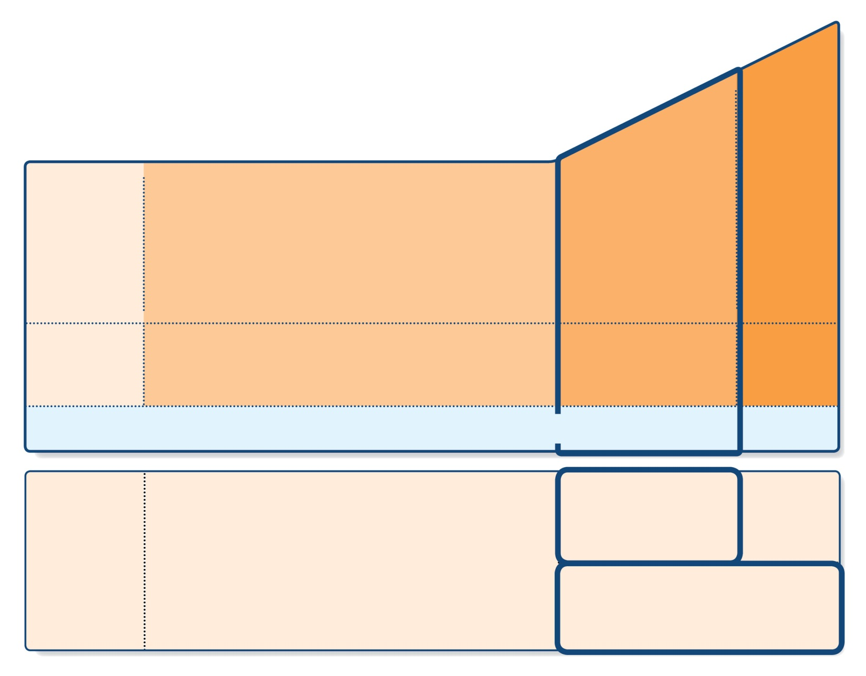
Step 3 (children ≤5 years) – medium dose ICS + as-needed inhaled SABA
STEP 4
PREFERRED CONTROLLER CHOICE
STEP 3
STEP 1
STEP 2
Continue controller & refer for specialist assessment
Double ‘low dose’ ICS
Daily low dose ICS
Other controller options
Leukotriene receptor antagonist (LTRA)
Intermittent ICS
Low dose ICS + LTRA
Add LTRA
Inc. ICS frequency
Add intermitt ICS
As-needed short-acting beta₂-agonist (all children)
RELIEVER
CONSIDER THIS STEP FOR CHILDREN WITH:
Infrequent viral wheezing and no or few interval symptoms
Symptom pattern consistent with asthma and asthma symptoms not well-controlled, or ≥3 exacerbations per year
Symptom pattern not consistent with asthma but wheezing episodes occur frequently, e.g. every 6–8 weeks. Give diagnostic trial for 3 months.
Asthma diagnosis, and not well-controlled on low dose ICS
Not well-controlled on double ICS
First check diagnosis, inhaler skills, adherence, exposures
GINA 2017

Slide 46
Step 3 (children ≤5 years) – medium dose ICS + as-needed inhaled SABA
Indication
Asthma diagnosis, and symptoms not well-controlled on low dose ICS
First check symptoms are due to asthma, and check adherence, inhaler technique and environmental exposures
Preferred option: medium dose ICS with as-needed inhaled SABA
Review response after 3 months
Other options
Consider adding LTRA to low dose ICS (based on data from older children)
GINA 2017

Slide 47
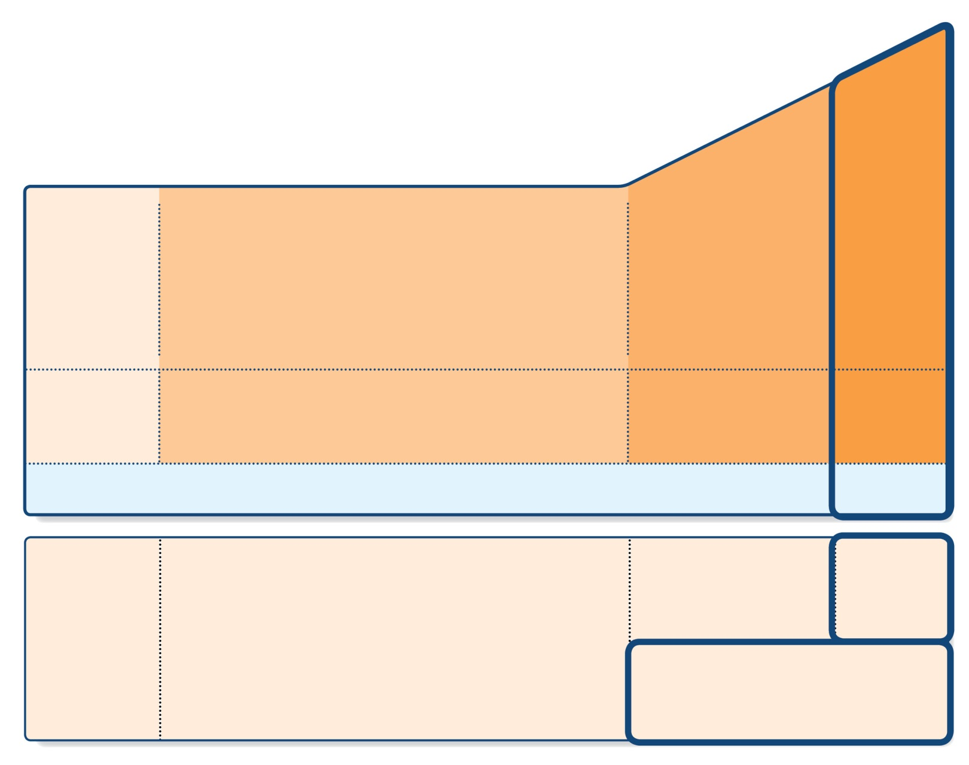
Step 4 (children ≤5 years) – refer for expert assessment
STEP 4
PREFERRED CONTROLLER CHOICE
STEP 3
STEP 1
STEP 2
Continue controller & refer for specialist assessment
Double ‘low dose’ ICS
Daily low dose ICS
Other controller options
Leukotriene receptor antagonist (LTRA)
Intermittent ICS
Low dose ICS + LTRA
Add LTRA
Inc. ICS frequency
Add intermitt ICS
As-needed short-acting beta₂-agonist (all children)
RELIEVER
CONSIDER THIS STEP FOR CHILDREN WITH:
Infrequent viral wheezing and no or few interval symptoms
Symptom pattern consistent with asthma and asthma symptoms not well-controlled, or ≥3 exacerbations per year
Symptom pattern not consistent with asthma but wheezing episodes occur frequently, e.g. every 6–8 weeks. Give diagnostic trial for 3 months.
Asthma diagnosis, and not well-controlled on low dose ICS
Not well-controlled on double ICS
First check diagnosis, inhaler skills, adherence, exposures
GINA 2017)

Slide 48
Step 4 (children ≤5 years) – refer for expert assessment
Indication
Asthma diagnosis, and symptoms not well-controlled on medium dose ICS
First check symptoms are due to asthma, and check adherence, inhaler technique and environmental exposures
Preferred option: continue controller treatment and refer for expert assessment
Other options (preferably with specialist advice)
Higher dose ICS and/or more frequent dosing (for a few weeks)
Add LTRA, theophylline or low dose OCS (for a few weeks only)
Add intermittent ICS to regular daily ICS if exacerbations are the main problem
ICS/LABA not recommended in this age group
GINA 2017

Slide 49
‘Low dose’ inhaled corticosteroids (mcg/day) for children ≤5 years
Inhaled corticosteroid | Low daily dose (mcg)
Beclometasone dipropionate (HFA) | 100
Budesonide (pMDI + spacer) | 200
Budesonide (nebulizer) | 500
Fluticasone propionate (HFA) | 100
Ciclesonide | 160
Mometasone furoate | Not studied below age 4 years
Triamcinolone acetonide | Not studied in this age group
This is not a table of equivalence
A low daily dose is defined as the dose that has not been associated with clinically adverse effects in trials that included measures of safety
GINA 2017, Box 6-6
GINA 2017

Slide 50
Choosing an inhaler device for children ≤5 years
Age | Preferred device | Alternate device
0–3 years | Pressurized metered dose inhaler plus dedicated spacer with face mask | Nebulizer with face mask
4–5 years | Pressurized metered dose inhaler plus dedicated spacer with mouthpiece | Pressurized metered dose inhaler plus dedicated spacer with face mask, or nebulizer with mouthpiece or face mask
GINA 2017, Box 6-6
GINA 2017

Slide 51
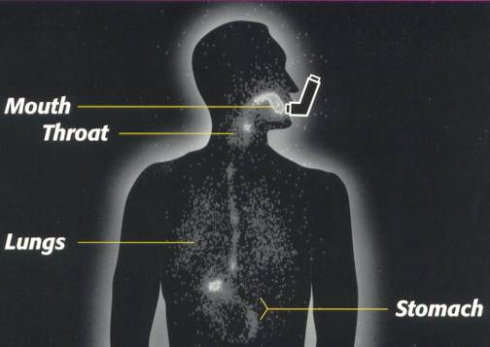
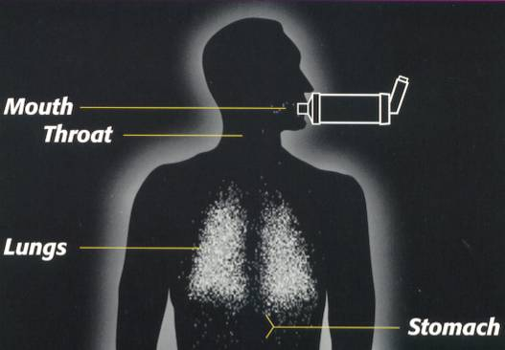
Without Spacer
1998, Respironics Inc.
With Spacer
1998, Respironics Inc.

Slide 52
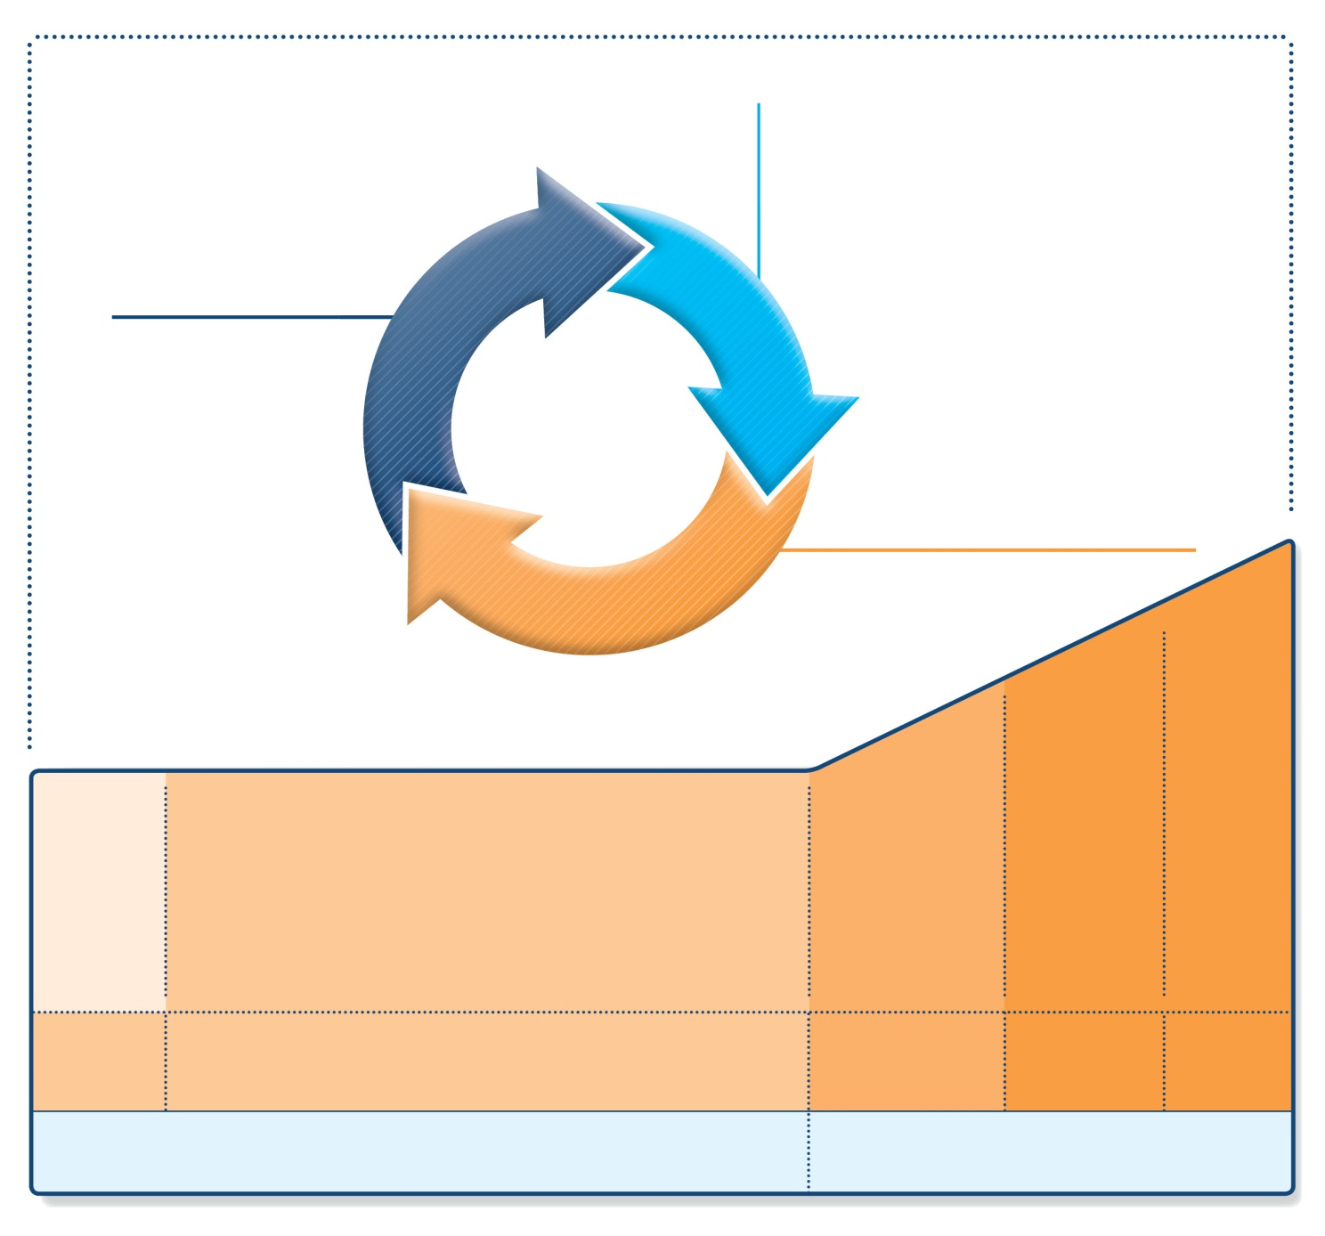
Adolescents and children 6–11 years
UPDATED 2017
Diagnosis
Symptom control & risk factors (including lung function)
Inhaler technique & adherence
Patient preference
ASSESS
REVIEW RESPONSE
Symptoms
Exacerbations
Side-effects
Patient satisfaction
Lung function
ADJUST TREATMENT
Asthma medications
Non-pharmacological strategies
Treat modifiable risk factors
STEP 5
STEP 4
STEP 1
STEP 2
STEP 3
Refer for add-on treatment
e.g.
tiotropium,* anti-IgE, anti-IL5*
*Not for children <12 years
**For children 6-11 years, the preferred Step 3 treatment is medium dose ICS
#For patients prescribed BDP/formoterol or BUD/ formoterol maintenance and reliever therapy
 Tiotropium by mist inhaler is an add-on treatment for patients ≥12 years with a history of exacerbations
PREFERRED CONTROLLER CHOICE
Med/high ICS/LABA
Low dose ICS
Low dose ICS/LABA**
Other controller options
Consider low dose ICS
Leukotriene receptor antagonists (LTRA)
Low dose theophylline*
Med/high dose ICS
Low dose ICS+LTRA
(or + theoph*)
Add tiotropium*
High dose ICS + LTRA (or + theoph*)
Add low dose OCS
RELIEVER
As-needed short-acting beta²-agonist (SABA)
As-needed SABA or low dose ICS/formoterol#
GINA 2017

Slide 53
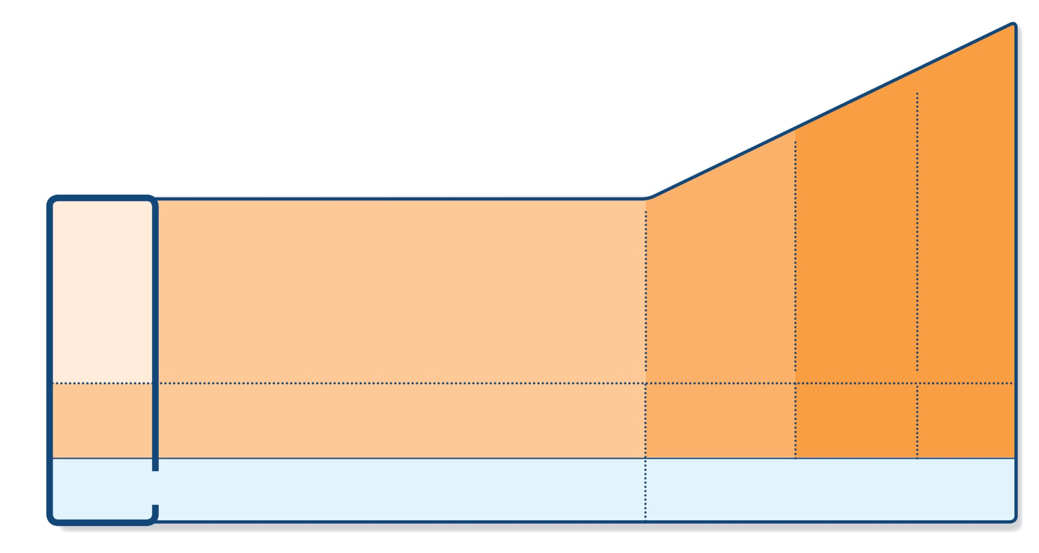
Step 1 – as-needed inhaled short-acting beta₂-agonist (SABA)
STEP 5
STEP 4
PREFERRED CONTROLLER CHOICE
STEP 1
STEP 2
STEP 3
Refer for add-on treatment
e.g.
tiotropium,* anti-IgE, anti-IL5*
Med/high ICS/LABA
Low dose ICS/LABA**
Low dose ICS
Other controller options
Consider low dose ICS
Leukotriene receptor antagonists (LTRA)
Low dose theophylline*
Med/high dose ICS
Low dose ICS+LTRA
(or + theoph*)
Add tiotropium*
High dose ICS + LTRA (or + theoph*)
Add low dose OCS
As-needed short-acting beta₂-agonist (SABA)
As-needed SABA or low dose ICS/formoterol#
RELIEVER
*Not for children <12 years
**For children 6-11 years, the preferred Step 3 treatment is medium dose ICS
#For patients prescribed BDP/formoterol or BUD/ formoterol maintenance and reliever therapy
 Tiotropium by mist inhaler is an add-on treatment for patients ≥12 years with a history of exacerbations
GINA 2017

Slide 54
Step 1 – as-needed reliever inhaler
Preferred option: as-needed inhaled short-acting beta₂-agonist (SABA)
SABAs are highly effective for relief of asthma symptoms
However …. there is insufficient evidence about the safety of treating asthma with SABA alone
This option should be reserved for patients with infrequent symptoms (less than twice a month) of short duration, and with no risk factors for exacerbations
Other options
Consider adding regular low dose inhaled corticosteroid (ICS) for patients at risk of exacerbations
GINA 2017

Slide 55
Levels of Asthma Control (Assess patient impairment)
Characteristic | Controlled (All of the following) | Partly controlled (Any present in any week) | Uncontrolled
Daytime symptoms | Twice or less per week | More than twice per week | 3 or more features of partly controlled asthma present in any week
Limitations of activities | None | Any
Nocturnal symptoms / awakening | None | Any
Need for rescue / “reliever” treatment | Twice or less per week | More than twice per week
Lung function (PEF or FEV₁) | Normal | < 80% predicted or personal best (if known) on any day
Assessment of Future Risk (risk of exacerbations, instability, rapid decline in lung function, side effects)

Slide 56
LEVEL OF CONTROL
REDUCE
TREATMENT OF ACTION
maintain and find lowest controlling step
controlled
consider stepping up to gain control
partly controlled
uncontrolled
step up until controlled
INCREASE
exacerbation
treat as exacerbation
REDUCE
INCREASE
TREATMENT STEPS
STEP
1
STEP
2
STEP
3
STEP
4
STEP
5

Slide 57
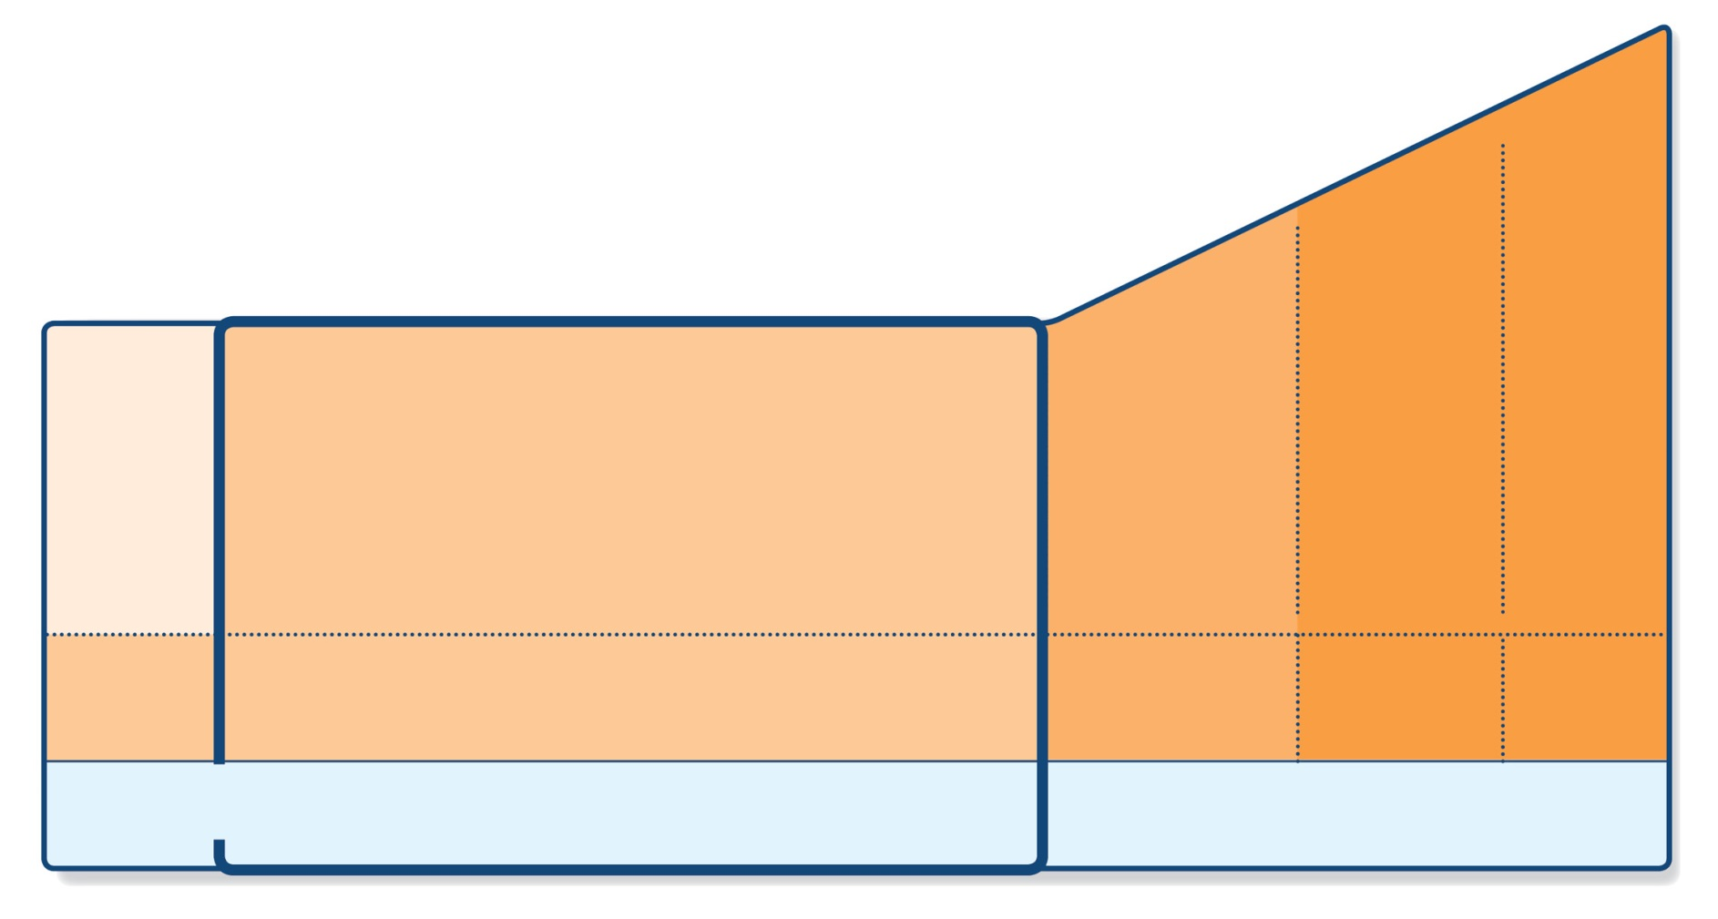
Step 2 – low-dose controller + as-needed inhaled SABA
STEP 5
STEP 4
PREFERRED CONTROLLER CHOICE
STEP 1
STEP 2
STEP 3
Refer for add-on treatment
e.g.
tiotropium,* anti-IgE, anti-IL5*
Med/high ICS/LABA
Low dose ICS/LABA**
Low dose ICS
Other controller options
Consider low dose ICS
Leukotriene receptor antagonists (LTRA)
Low dose theophylline*
Med/high dose ICS
Low dose ICS+LTRA
(or + theoph*)
Add tiotropium*
High dose ICS + LTRA (or + theoph*)
Add low dose OCS
As-needed short-acting beta₂-agonist (SABA)
As-needed SABA or low dose ICS/formoterol#
RELIEVER
*Not for children <12 years
**For children 6-11 years, the preferred Step 3 treatment is medium dose ICS
#For patients prescribed BDP/formoterol or BUD/ formoterol maintenance and reliever therapy
 Tiotropium by mist inhaler is an add-on treatment for patients ≥12 years with a history of exacerbations
GINA 2017

Slide 58
Step 2 – Low dose controller + as-needed SABA
Preferred option: regular low dose ICS with as-needed inhaled SABA
Low dose ICS reduces symptoms and reduces risk of exacerbations and asthma-related hospitalization and death
Other options
Leukotriene receptor antagonists (LTRA) with as-needed SABA
Less effective than low dose ICS
May be used for some patients with both asthma and allergic rhinitis, or if patient will not use ICS
Combination low dose ICS/long-acting beta₂-agonist (LABA) with as-needed SABA
Reduces symptoms and increases lung function compared with ICS
More expensive, and does not further reduce exacerbations
Intermittent ICS with as-needed SABA for purely seasonal allergic asthma with no interval symptoms
Start ICS immediately symptoms commence, and continue for 4 weeks after pollen season ends
GINA 2017

Slide 59
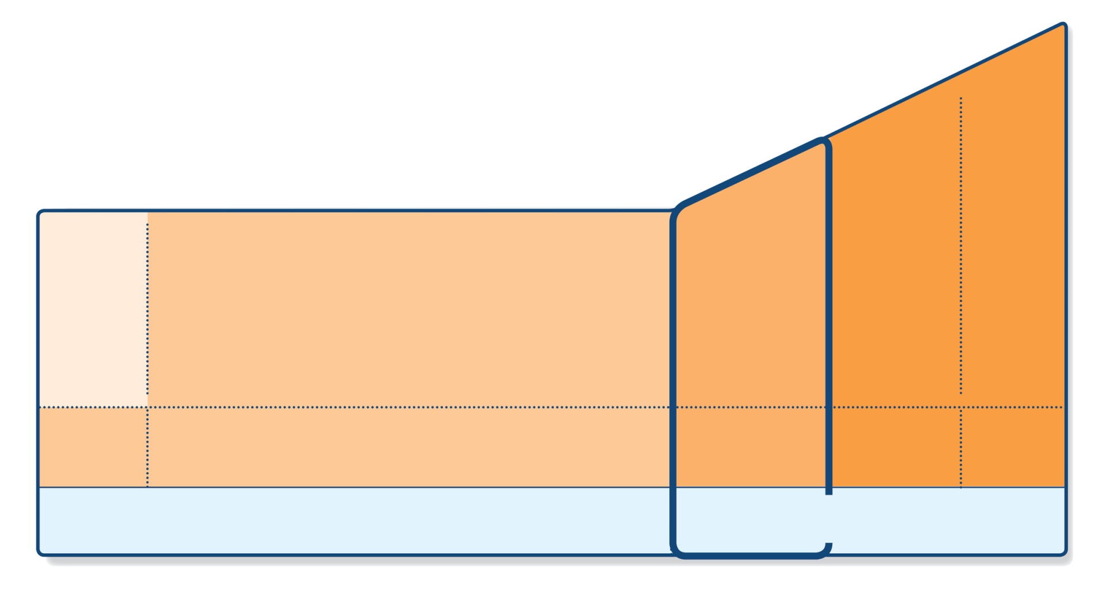
Step 3 – one or two controllers + as-needed inhaled reliever
STEP 5
STEP 4
PREFERRED CONTROLLER CHOICE
STEP 1
STEP 2
STEP 3
Refer for add-on treatment
e.g.
tiotropium,* anti-IgE, anti-IL5*
Med/high ICS/LABA
Low dose ICS/LABA**
Low dose ICS
Other controller options
Consider low dose ICS
Leukotriene receptor antagonists (LTRA)
Low dose theophylline*
Med/high dose ICS
Low dose ICS+LTRA
(or + theoph*)
Add tiotropium*
High dose ICS + LTRA (or + theoph*)
Add low dose OCS
As-needed short-acting beta₂-agonist (SABA)
As-needed SABA or low dose ICS/formoterol#
RELIEVER
*Not for children <12 years
**For children 6-11 years, the preferred Step 3 treatment is medium dose ICS
#For patients prescribed BDP/formoterol or BUD/ formoterol maintenance and reliever therapy
 Tiotropium by mist inhaler is an add-on treatment for patients ≥12 years with a history of exacerbations
GINA 2017
© Global Initiative for Asthma

Slide 60
Step 3 – one or two controllers + as-needed inhaled reliever
Before considering step-up
Check inhaler technique and adherence, confirm diagnosis
Adults/adolescents: preferred options are either combination low dose ICS/LABA maintenance with as-needed SABA, OR combination low dose ICS/formoterol maintenance and reliever regimen*
Adding LABA reduces symptoms and exacerbations and increases FEV₁, while allowing lower dose of ICS
In at-risk patients, maintenance and reliever regimen significantly reduces exacerbations with similar level of symptom control and lower ICS doses compared with other regimens
Children 6-11 years: preferred option is medium dose ICS with as-needed SABA
Other options
Adults/adolescents: Increase ICS dose or add LTRA or theophylline (less effective than ICS/LABA)
Adults: consider adding SLIT (see Non-pharmacological interventions)
Children 6-11 years – add LABA (similar effect as increasing ICS)
UPDATED 2017
*Approved only for low dose beclometasone/formoterol and low dose budesonide/formoterol
GINA 2017

Slide 61
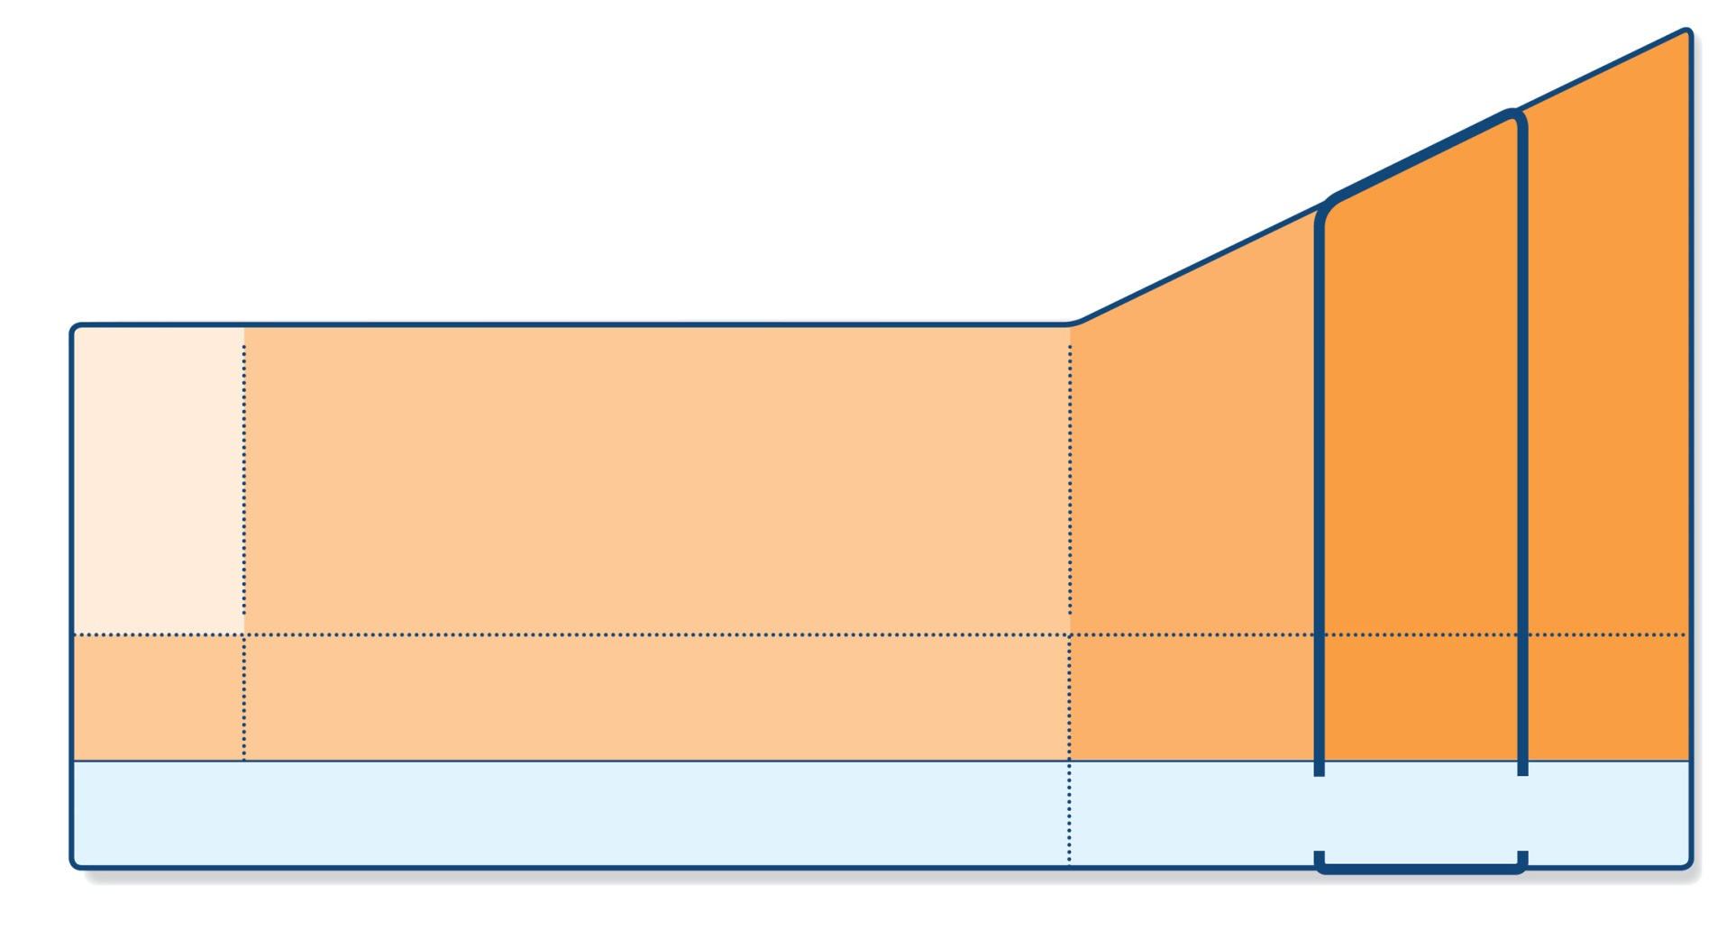
Step 4 – two or more controllers + as-needed inhaled reliever
STEP 5
STEP 4
PREFERRED CONTROLLER CHOICE
STEP 1
STEP 2
STEP 3
Refer for add-on treatment
e.g.
tiotropium,* anti-IgE, anti-IL5*
Med/high ICS/LABA
Low dose ICS/LABA**
Low dose ICS
Other controller options
Consider low dose ICS
Leukotriene receptor antagonists (LTRA)
Low dose theophylline*
Med/high dose ICS
Low dose ICS+LTRA
(or + theoph*)
Add tiotropium*
High dose ICS + LTRA (or + theoph*)
Add low dose OCS
As-needed short-acting beta₂-agonist (SABA)
As-needed SABA or low dose ICS/formoterol#
RELIEVER
*Not for children <12 years
**For children 6-11 years, the preferred Step 3 treatment is medium dose ICS
#For patients prescribed BDP/formoterol or BUD/ formoterol maintenance and reliever therapy
 Tiotropium by mist inhaler is an add-on treatment for patients ≥12 years with a history of exacerbations
GINA 2017
© Global Initiative for Asthma

Slide 62
Step 4 – two or more controllers + as-needed inhaled reliever
Before considering step-up
Check inhaler technique and adherence
Adults or adolescents: preferred option is combination low dose ICS/formoterol as maintenance and reliever regimen*, OR combination medium dose ICS/LABA with as-needed SABA
Children 6–11 years: preferred option is to refer for expert advice
Other options (adults or adolescents)
Tiotropium by mist inhaler may be used as add-on therapy for patients aged ≥12 years with a history of exacerbations
Adults: consider adding SLIT (see Non-pharmacological therapy)
Trial of high dose combination ICS/LABA, but little extra benefit and increased risk of side-effects
Increase dosing frequency (for budesonide-containing inhalers)
Add-on LTRA or low dose theophylline
UPDATED 2017
*Approved only for low dose beclometasone/formoterol and low dose budesonide/formoterol
GINA 2017

Slide 63
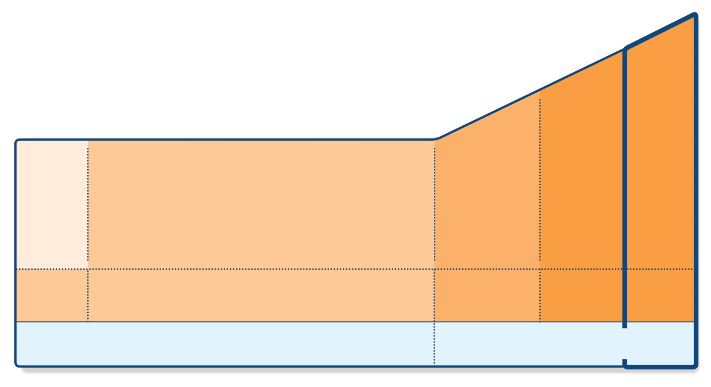
Step 5 – higher level care and/or add-on treatment
UPDATED 2017
STEP 5
STEP 4
PREFERRED CONTROLLER CHOICE
STEP 1
STEP 2
STEP 3
Refer for add-on treatment
e.g.
tiotropium,* anti-IgE, anti-IL5*
Med/high ICS/LABA
Low dose ICS/LABA**
Low dose ICS
Other controller options
Consider low dose ICS
Leukotriene receptor antagonists (LTRA)
Low dose theophylline*
Med/high dose ICS
Low dose ICS+LTRA
(or + theoph*)
Add tiotropium*
High dose ICS + LTRA (or + theoph*)
Add low dose OCS
As-needed short-acting beta₂-agonist (SABA)
As-needed SABA or low dose ICS/formoterol#
RELIEVER
*Not for children <12 years
**For children 6-11 years, the preferred Step 3 treatment is medium dose ICS
#For patients prescribed BDP/formoterol or BUD/ formoterol maintenance and reliever therapy
 Tiotropium by mist inhaler is an add-on treatment for patients ≥12 years with a history of exacerbations
GINA 2017,

Slide 64
Step 5 – higher level care and/or add-on treatment
Preferred option is referral for specialist investigation and consideration of add-on treatment
If symptoms uncontrolled or exacerbations persist despite Step 4 treatment, check inhaler technique and adherence before referring
Add-on tiotropium for patients ≥12 years with history of exacerbations
Add-on anti-IgE (omalizumab) for patients with severe allergic asthma
Add-on anti-IL5 (mepolizumab (SC) or reslizumab (IV)) for severe eosinophilic asthma (≥12 yrs)
Other add-on treatment options at Step 5 include:
Sputum-guided treatment: this is available in specialized centers; reduces exacerbations and/or corticosteroid dose
Add-on low dose oral corticosteroids (≤7.5mg/day prednisone equivalent): this may benefit some patients, but has significant systemic side-effects. Assess and monitor for osteoporosis
See ERS/ATS Severe Asthma Guidelines (Chung et al, ERJ 2014) for more detail
UPDATED 2017
GINA 2017

Slide 65
Low, medium and high dose inhaled corticosteroids Adults and adolescents (≥12 years)
Inhaled corticosteroid | Total daily dose (mcg)
 | Low | Medium | High
Beclometasone dipropionate (CFC) | 200–500 | >500–1000 | >1000
Beclometasone dipropionate (HFA) | 100–200 | >200–400 | >400
Budesonide (DPI) | 200–400 | >400–800 | >800
Ciclesonide (HFA) | 80–160 | >160–320 | >320
Fluticasone furoate (DPI) | 100 | n.a. | 200
Fluticasone propionate (DPI or HFA) | 100–250 | >250–500 | >500
Mometasone furoate | 110–220 | >220–440 | >440
Triamcinolone acetonide | 400–1000 | >1000–2000 | >2000
This is not a table of equivalence, but of estimated clinical comparability
Most of the clinical benefit from ICS is seen at low doses
High doses are arbitrary, but for most ICS are those that, with prolonged use, are associated with increased risk of systemic side-effects

Slide 66
Low, medium and high dose inhaled corticosteroids Children 6–11 years
Inhaled corticosteroid | Total daily dose (mcg)
 | Low | Medium | High
Beclometasone dipropionate (CFC) | 100–200 | >200–400 | >400
Beclometasone dipropionate (HFA) | 50–100 | >100–200 | >200
Budesonide (DPI) | 100–200 | >200–400 | >400
Budesonide (nebules) | 250–500 | >500–1000 | >1000
Ciclesonide (HFA) | 80 | >80–160 | >160
Fluticasone furoate (DPI) | n.a. | n.a. | n.a.
Fluticasone propionate (DPI) | 100–200 | >200–400 | >400
Fluticasone propionate (HFA) | 100–200 | >200–500 | >500
Mometasone furoate | 110 | ≥220–<440 | ≥440
Triamcinolone acetonide | 400–800 | >800–1200 | >1200
This is not a table of equivalence, but of estimated clinical comparability
Most of the clinical benefit from ICS is seen at low doses
High doses are arbitrary, but for most ICS are those that, with prolonged use, are associated with increased risk of systemic side-effects

Slide 67
Reviewing response and adjusting treatment
How often should asthma be reviewed?
1-3 months after treatment started, then every 3-12 months
During pregnancy, every 4-6 weeks
After an exacerbation, within 1 week
Stepping up asthma treatment
Sustained step-up, for at least 2-3 months if asthma poorly controlled
Important: first check for common causes (symptoms not due to asthma, incorrect inhaler technique, poor adherence)
Short-term step-up, for 1-2 weeks, e.g. with viral infection or allergen
May be initiated by patient with written asthma action plan
Day-to-day adjustment
For patients prescribed low-dose ICS/formoterol maintenance and reliever regimen*
Stepping down asthma treatment
Consider step-down after good control maintained for 3 months
Find each patient’s minimum effective dose, that controls both symptoms and exacerbations
ASSESS
REVIEW RESPONSE
ADJUST TREATMENT
*Approved only for low dose beclometasone/formoterol and low dose budesonide/formoterol
GINA 2017

Slide 68
General principles for stepping down controller treatment
Aim
To find the lowest dose that controls symptoms and exacerbations, and minimizes the risk of side-effects
When to consider stepping down
When symptoms have been well controlled and lung function stable for ≥3 months
No respiratory infection, patient not travelling, not pregnant
Prepare for step-down
Record the level of symptom control and consider risk factors
Make sure the patient has a written asthma action plan
Book a follow-up visit in 1-3 months
Step down through available formulations
Stepping down ICS doses by 25–50% at 3 month intervals is feasible and safe for most patients (Hagan et al, Allergy 2014)
See GINA 2017 report Box 3-7 for specific step-down options
Stopping ICS is not recommended in adults with asthma because of risk of exacerbations (Rank et al, JACI 2013)

Slide 69
Treating modifiable risk factors
Provide skills and support for guided asthma self-management
This comprises self-monitoring of symptoms and/or PEF, a written asthma action plan and regular medical review
Prescribe medications or regimen that minimize exacerbations
ICS-containing controller medications reduce risk of exacerbations
For patients with ≥1 exacerbations in previous year, consider low-dose ICS/formoterol maintenance and reliever regimen*
Encourage avoidance of tobacco smoke (active or ETS)
Provide smoking cessation advice and resources at every visit
For patients with severe asthma
Refer to a specialist center, if available, for consideration of add-on medications and/or sputum-guided treatment
For patients with confirmed food allergy:
Appropriate food avoidance
Ensure availability of injectable epinephrine for anaphylaxis
*Approved only for low dose beclometasone/formoterol and low dose budesonide/formoterol

Slide 70
Non-pharmacological interventions
Avoidance of tobacco smoke exposure
Provide advice and resources at every visit; advise against exposure of children to environmental tobacco smoke (house, car)
Physical activity
Encouraged because of its general health benefits. Provide advice about exercise-induced bronchoconstriction
Occupational asthma
Ask patients with adult-onset asthma about work history. Remove sensitizers as soon as possible. Refer for expert advice, if available
Avoid medications that may worsen asthma
Always ask about asthma before prescribing NSAIDs or beta-blockers
Remediation of dampness or mold in homes
Reduces asthma symptoms and medication use in adults
Sublingual immunotherapy (SLIT)
Consider as add-on therapy in adult HDM-sensitive patients with allergic rhinitis who have exacerbations despite ICS treatment, provided FEV1 is 70% predicted
UPDATED 2017

Slide 71
Asthma Review: Checklist
The right diagnosis
Check symptom control (ACT)
Ask about and address smoking (child and parent)
The right treatment at the right time (step-wise)
Before initiating a new drug/step: check compliance with existing therapies, inhaler technique and try to eliminate trigger factors.
Minimise side effects from treatment (i.e. growth if on high dose ICS)
The right inhaler, correct technique
Give inhaler training, ensure correct technique before writing prescription
Notes:
Referral pathways for smoking – find info to put in handout.
Side effects – STEROID CARD
SHINE – handout
Demonstrate competence before they leave with their new inhaler.

Slide 72
Asthma Review: Checklist
The gold standard is MDI + spacer
Give Asthma education
(repetition, reinforcement, signpost/give resources)
All children should have an Asthma Plan
Promote self-management
Compliance
Need regular review
Annual review
Review at 48-72 hrs and 30 days post exacerbation/admission
Notes:
Referral pathways for smoking – find info to put in handout.
Side effects – STEROID CARD
SHINE – handout
Demonstrate competence before they leave with their new inhaler.

Slide 73
Treatment failure
True dosage of drugs?
True usage of drugs?
Concomitant disease?
Bad environment condition?
The right diagnosis?

