Slide 1
Atopic Dermatitis
Doç Dr H.Tekin Nacaroğlu
Çocuk İmmünolojisi ve Allerji Hastalıkları

Slide 2
Atopic Dermatitis

Slide 3
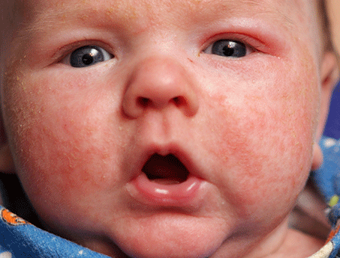
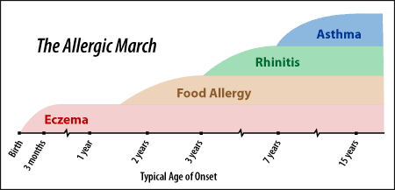
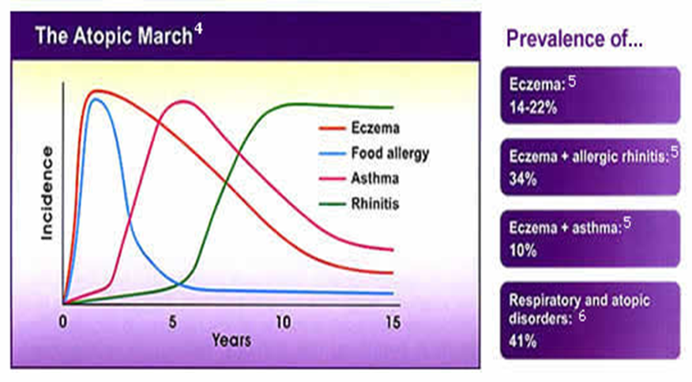
Atopic Dermatitis
Notes:
Çocuklardaki en sık kronik deri hastalığı
En erken çıkan atopik hastalık
AD olan çocuklarda astım ve alerjik rinit gelişme riski artmıştır (atopik marş)

Slide 4
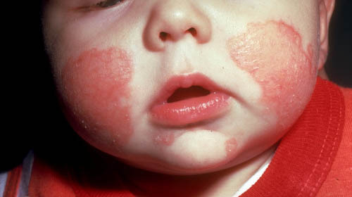
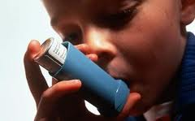
Brown SJ. J Allergy Clin Immunol 2011
Early onset AD
Severe AD
Concomitant food allergy
FLG mutation
%100 ASTHMA

Slide 5
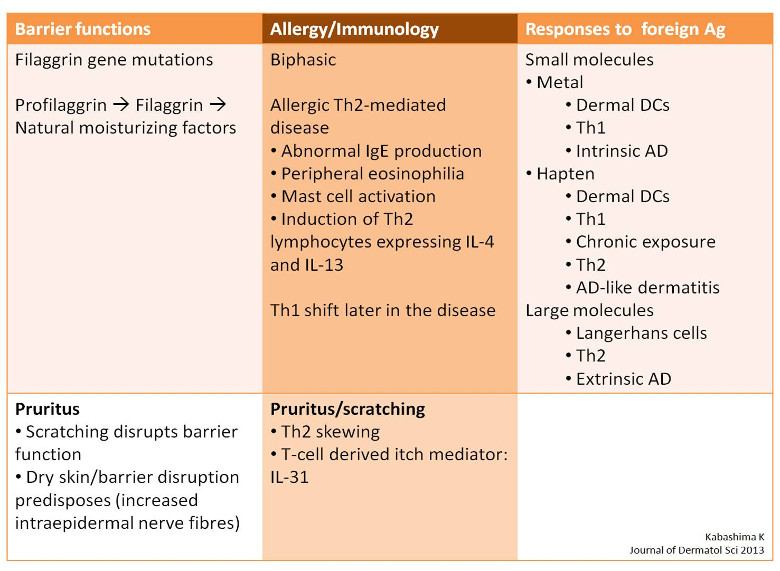
Immunopathology

Slide 6
Immunopathology
Notes:
Deri bariyeri bozukluğu
Derinin doğal bağışıklık cevabında azalma
Alerjenlere ve enfeksiyöz etkenlere T hücrelerinin artmış cevabı

Slide 7
Atopic Dermatitis Triggers
sweating
Contact
irritants
triggers
Stress
climate
Microbial
agents
Allergens
Notes:
Environmental allergens repeatedly have been shown to trigger exacerbations of atopic dermatitis in susceptible individuals. Contact irritants, climate, sweating, aeroallergens, microbial organisms, and stress/psyche commonly trigger exacerbations.
Contact irritants (eg, soaps, solvents, wool clothing, mechanical irritants, detergents, preservatives, perfumes)
Microbial agents (eg, S aureus, Pityrosporum yeasts, Candida organisms, Trichophyton dermatophytes)
Stress may trigger atopic dermatitis at the sites of activated cutaneous nerve endings, possibly by the actions of substance P, vasoactive intestinal peptide (VIP), or via the adenyl cyclase–cyclic adenosine monophosphate (cAMP) system.

Slide 8
Allergens
<3 age
cow's milk, soy, wheat, eggs, fish and peanuts
>3 age
Aeroallergens
(eg, house dust mite, molds, pollen, dander)
Notes:
>3 age yaşından sonra yiyecek allerjisi azalır aeroallerjen duyarlılığı artar (ev tozu akarları, yabani otlar, hayvanlar ve mantarlar)

Slide 9
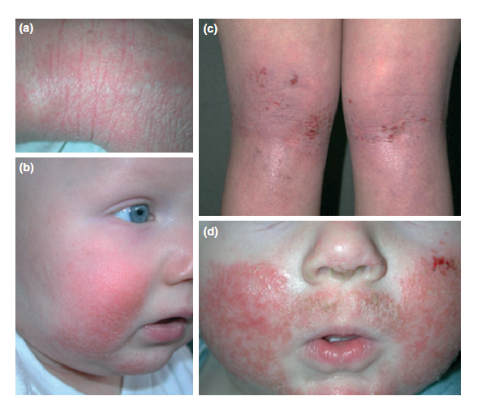
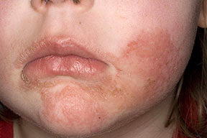
Physical Examination
Lichenification
Erythema
Erythema, excoriation, Lichenification
Infected eczema
Notes:
likenifikasyon Genellikle kronik surtunme bolgelerinde deri katlantilariyla artan plak.
ekskoriasyon Derin bir tirnak izi gibi genellikle cizgisel bir travmatik erozyon veya ulser

Slide 10
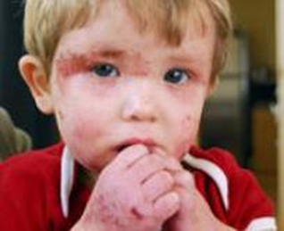
Physical Examination
The following three classes of skin lesions are recognized:
Acute - Intensely pruritic erythematous papules and vesicles overlying erythematous skin; frequently associated with extensive excoriations and erosions accompanied by serous exudates
Subacute - Erythema, excoriation, and scaling
Chronic - Thickened plaques of skin, accentuated skin markings (lichenification), fibrotic papules (prurigo nodularis); possible coexistence of all 3 types of lesions in chronic atopic dermatitis

Slide 11
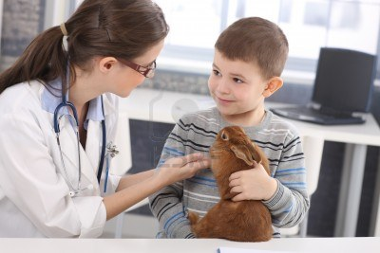
Physical Examination
Typical locations of lesions by age are as follows:
Nonmobile infant - Face and scalp
Crawling infant - Extensor surfaces of extremities, trunk, face, and neck
Older child and adolescent - Wrists, ankles, antecubital fossae, popliteal fossae, and neck
Adult - May be limited to hand and foot eczema

Slide 12
Diagnosis of Atopic Dermatitis
This requires the presence of three or more major and three or more minor criteria as defined by Hanifin and Rajka
3 major + 3 minor criteria
Major criteria
Pruritus
Lichenification
Chronic or chronically relapsing course
Personal or family history of atopy

Slide 13
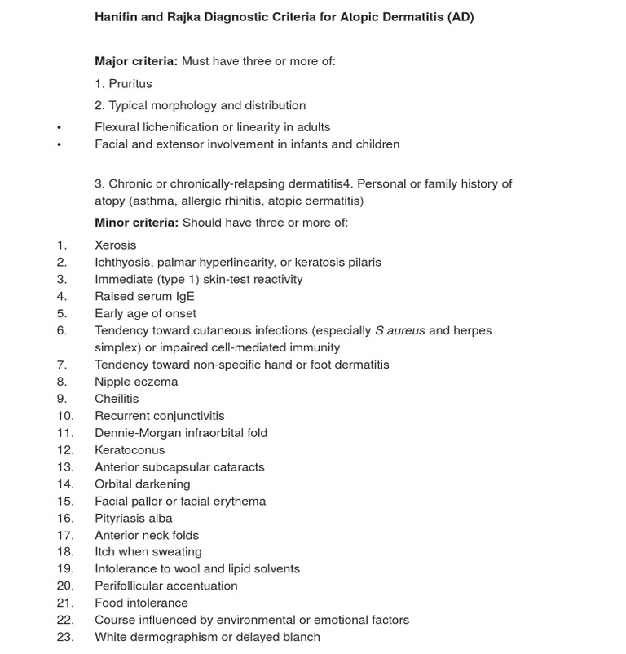
Minor criteria
Ann Dermatol:2010;22(2).125-37

Slide 14
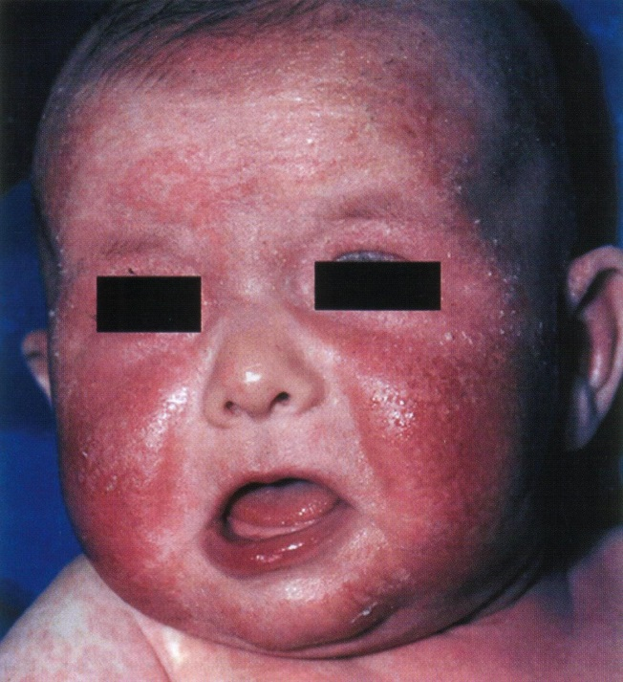
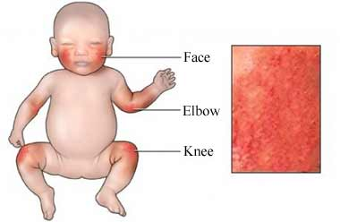
Infantile Phase ( 0-2 years )
Onset around 3 months of age.
Under 6 months, the face and scalp commonly involved, at an older age, limb folds and hands involved

Slide 15
Infantile Phase ( 0-2 years )
Diaper area not effected tipically!
Why ;
Diaper section is more wet
Conserved from outer irritants
Conserved from scratching

Slide 16
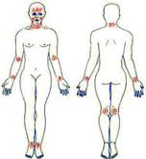
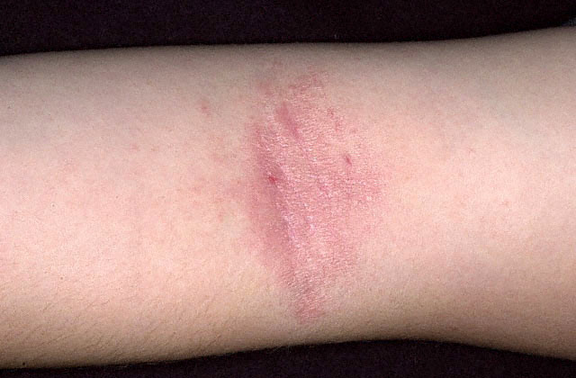
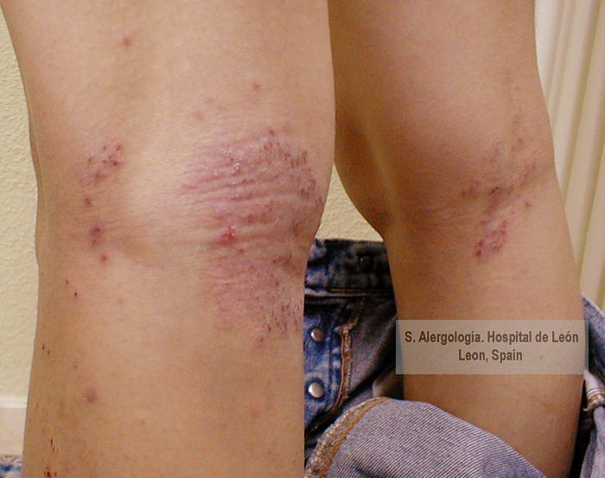
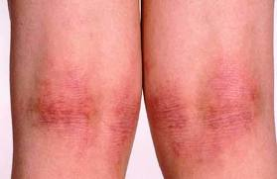
Childhood Phase ( 2-12 years )
Papular areas in flexural regions common.
Persistent rubbing and scratching leads to lichenified plaques and excoriations
Ann Dermatol 2010:22(2);125-137

Slide 17
Laboratory Studies
No definitive laboratory tests are used to diagnose atopic dermatitis (AD).
Elevated serum immunoglobulin E (IgE) levels and peripheral blood eosinophilia occur in most individuals with atopic dermatitis, and these findings may be useful in confirming the atopic status of suspected cases.

Slide 18
All That Itches Is Not AD
Differential diagnosis
Wiskott Aldrich Send, SCID, Hiper IgE Send (OD ve OR), IPEX sendromu

Slide 20
Treatment
Elimination of factors.
Elimination allergens
Food (milk, egg, nut)
Elimination of irritants
Contact irritants (eg, soaps, solvents, wool clothing, mechanical irritants, detergents, preservatives, perfumes
İrritant clohtes
Avoding stress,
Short nails
Notes:
Öneriler: Phsı nötr sabun ve şampuan kullanılmalı, cilt ovalanmamalı, ılık suyla yıkanılmalı

Slide 21
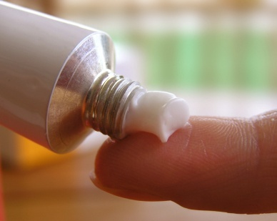
Moistener
Hydrophobic-based preparations should be applied twice a day with a slightly moist skin after bathing
If it is not applied after bathing, it will not be effective.
More implementation in winter

Slide 22
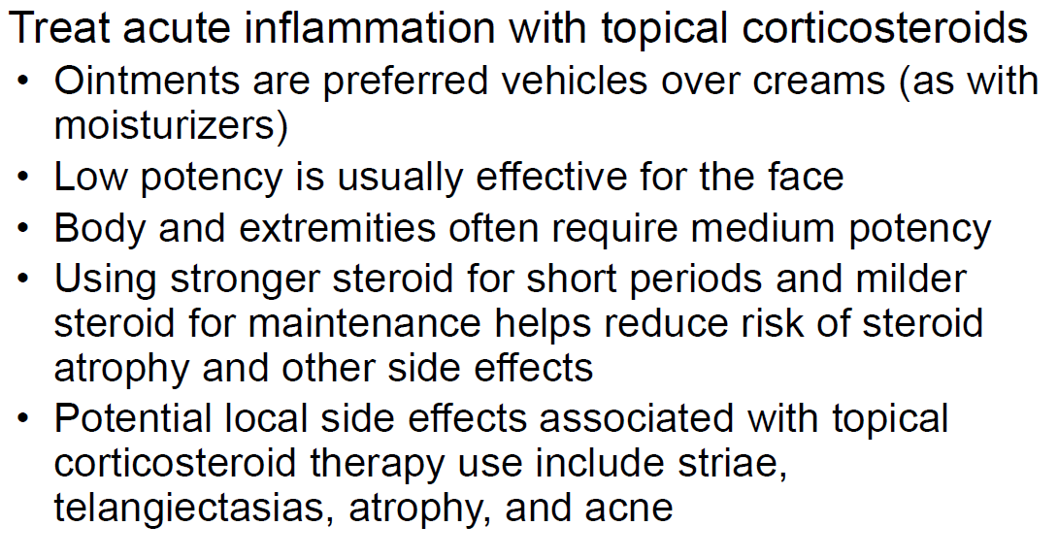
Treatment Topical corticosteroids
Notes:
High PotencyTopical corticosteroids
Likenifiye bölgede kısa süreli (yüz ve deri kıvrımında kullanılmaz)
Çocuklarda düşük ve orta etkili ilk tercih

Slide 23
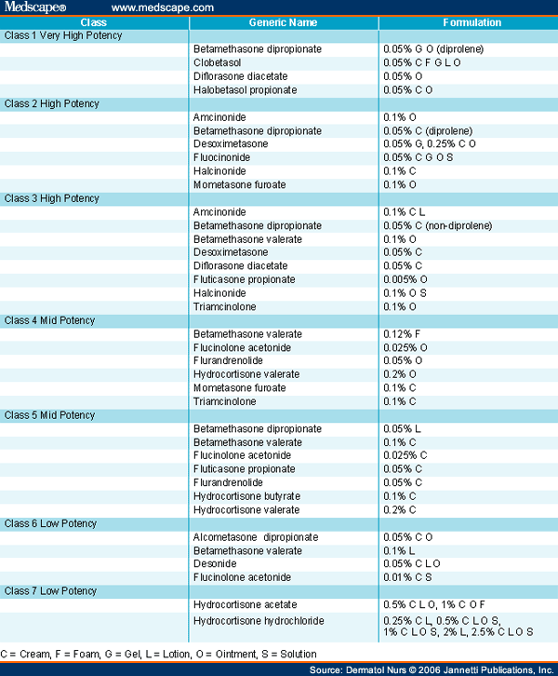
Topical corticosteroids

Slide 24
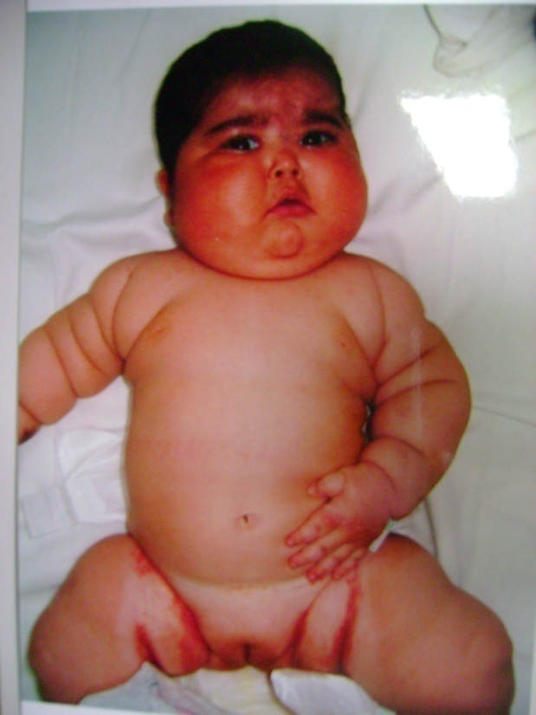
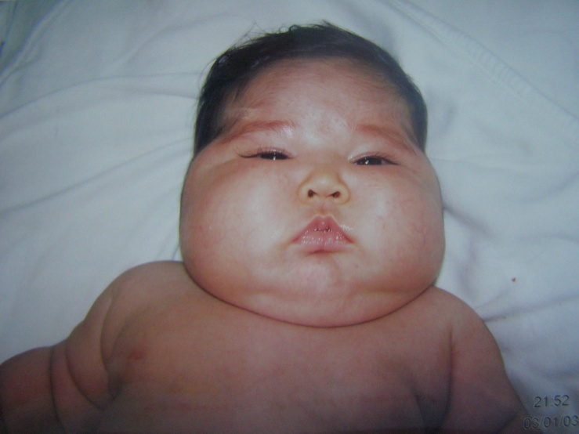
Topical corticosteroids
Can D, Çoban A, Gülle S, Asilsoy S, Büyükinan M, Serdaroğlu E, Bak M. Topikal glikokortikoid kullanımına bağlı Cushing Sendromu. Astım Allerji İmmunoloji 2007; 5: 121-124.
Notes:
Aylık steroid miktarı süt çocukları için 15 gr, çocuklarda 30 gr ı geçmemeli

Slide 25
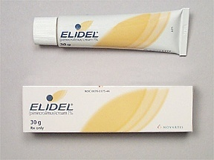
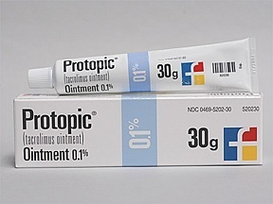
Notes:
Takrolimus merhem %0.1, %0.03
Pimekrolimus krem %1
2 yaş altında ruhsatı yok çünkü çalışma yok
Proaktif tedavi olarak orta-ağır AD’de yararı
ve maliyet etkin olduğu gösterilmiş.

Slide 26
Anti-pruritus
Notes:
Antihistaminiklerin etkisi sınırlı
Öz. sedasyon yapan antihistaminikler
( hidroksizin- difenhidramin) geceleri tercih edilebilir.
Lokal antihistaminikler önerilmez.

Slide 27
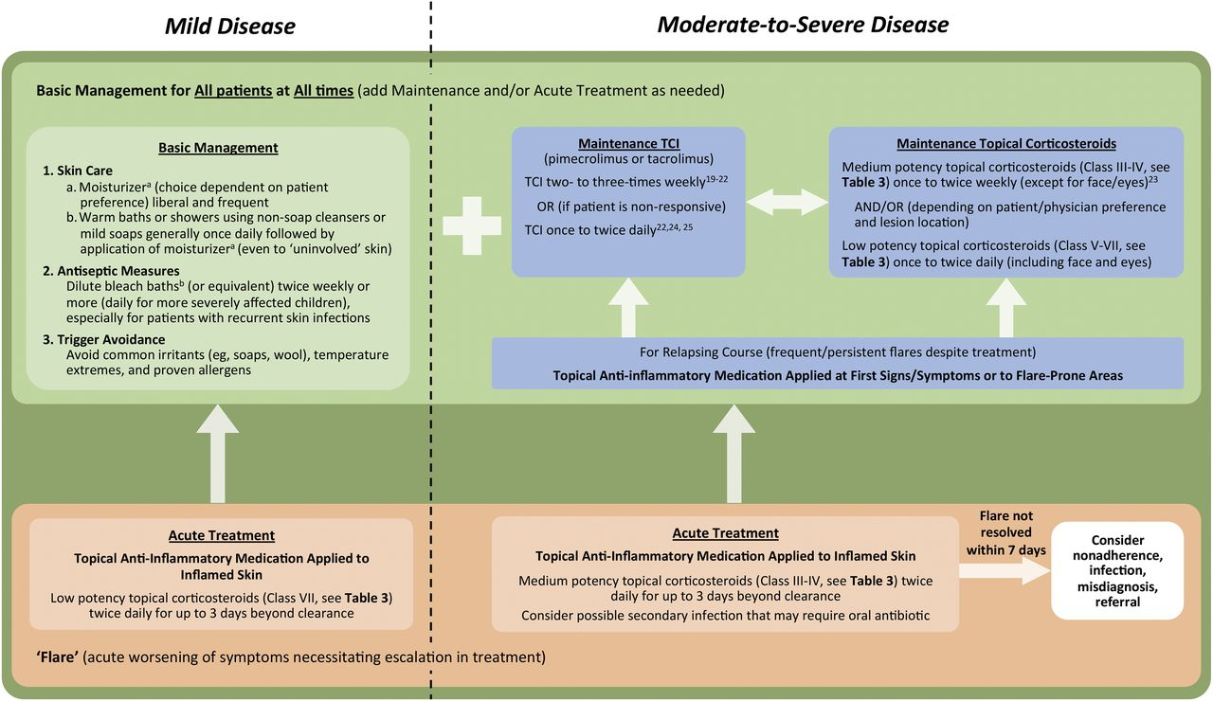
Treatment

Slide 28
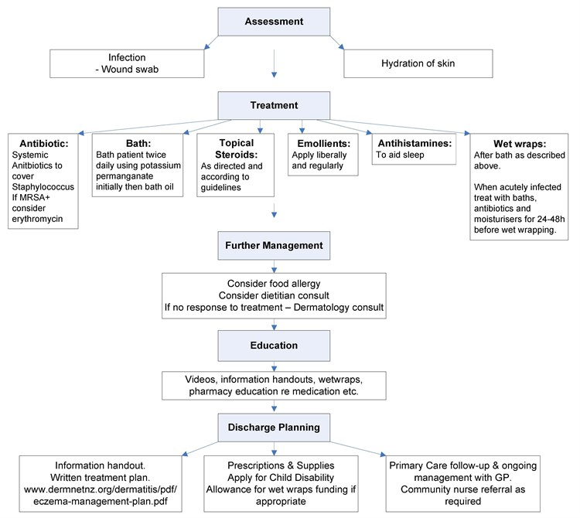

Slide 29
